Slide 1
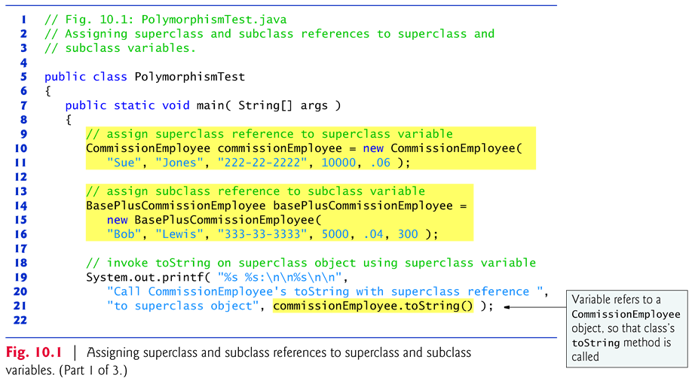
Example 1: Polymorphism when both parent and child classes are concrete (1/4) Note: Fig.10.1 uses Fig.9.10 and Fig.11
Line 10 and 14 : horizontal mapping
Line 30: upcasting
Line 10 and 14: natural mapping (non-crossover)

Slide 2
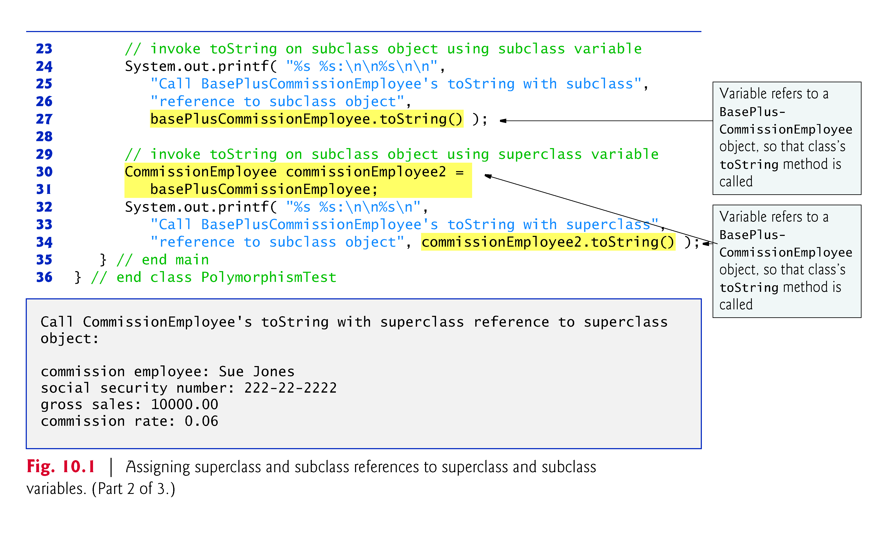
Example 1: Polymorphism when both parent and child classes are concrete (2/4) Note: Fig.10.1 uses Fig.9.10 and Fig.11
Line 30 : crossover mapping
Hence, tostring() of the subclass version is invoked at line 34

Slide 3
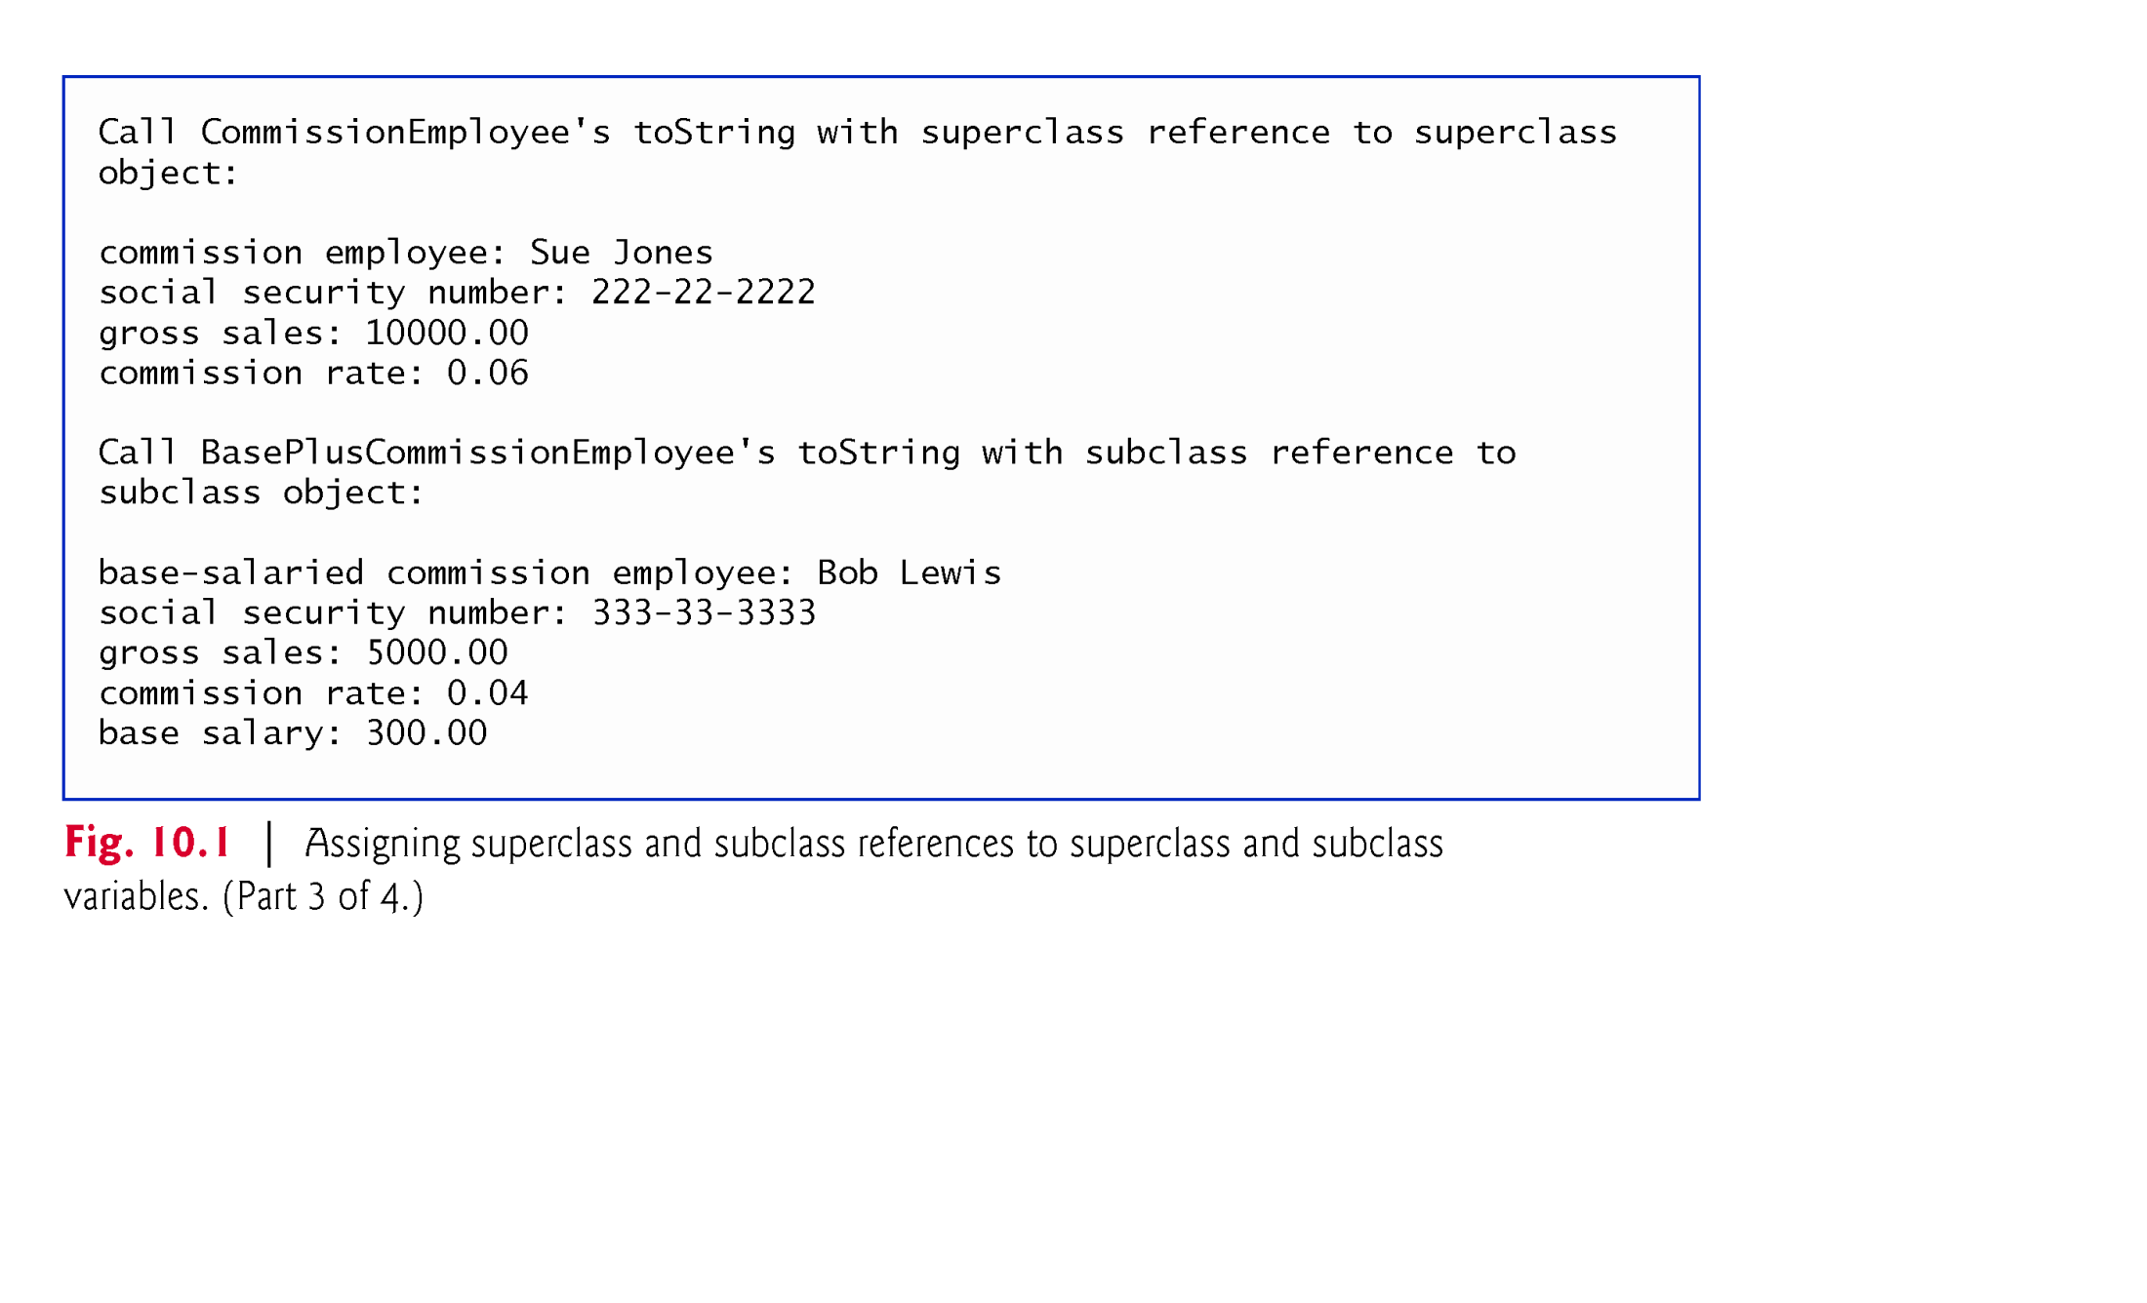
Example 1: Polymorphism when both parent and child classes are concrete (3/4) Note: Fig.10.1 uses Fig.9.10 and Fig.11

Slide 4
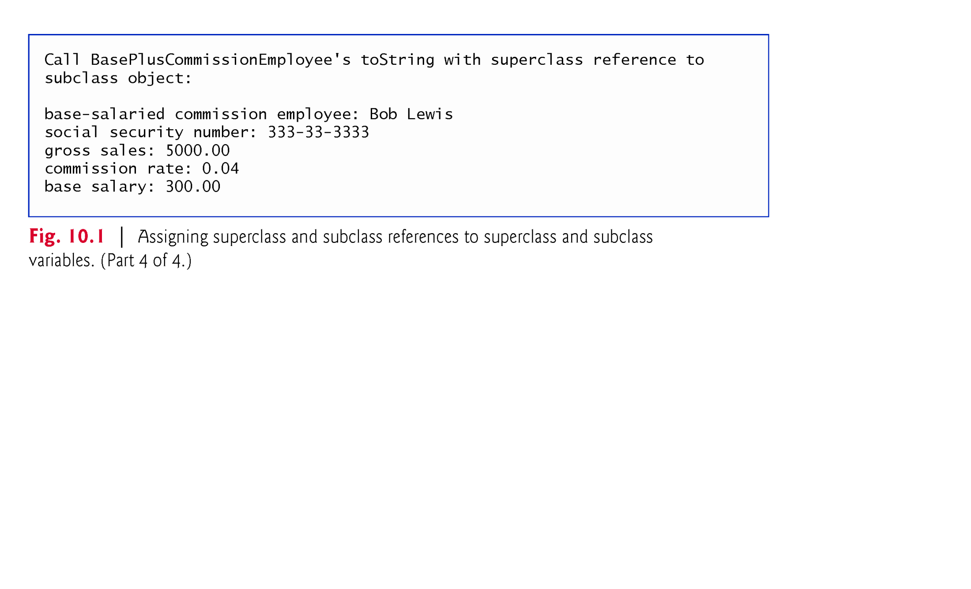
Example 1: Polymorphism when both parent and child classes are concrete (4/4) Note: Fig.10.1 uses Fig.9.10 and Fig.11

Slide 5
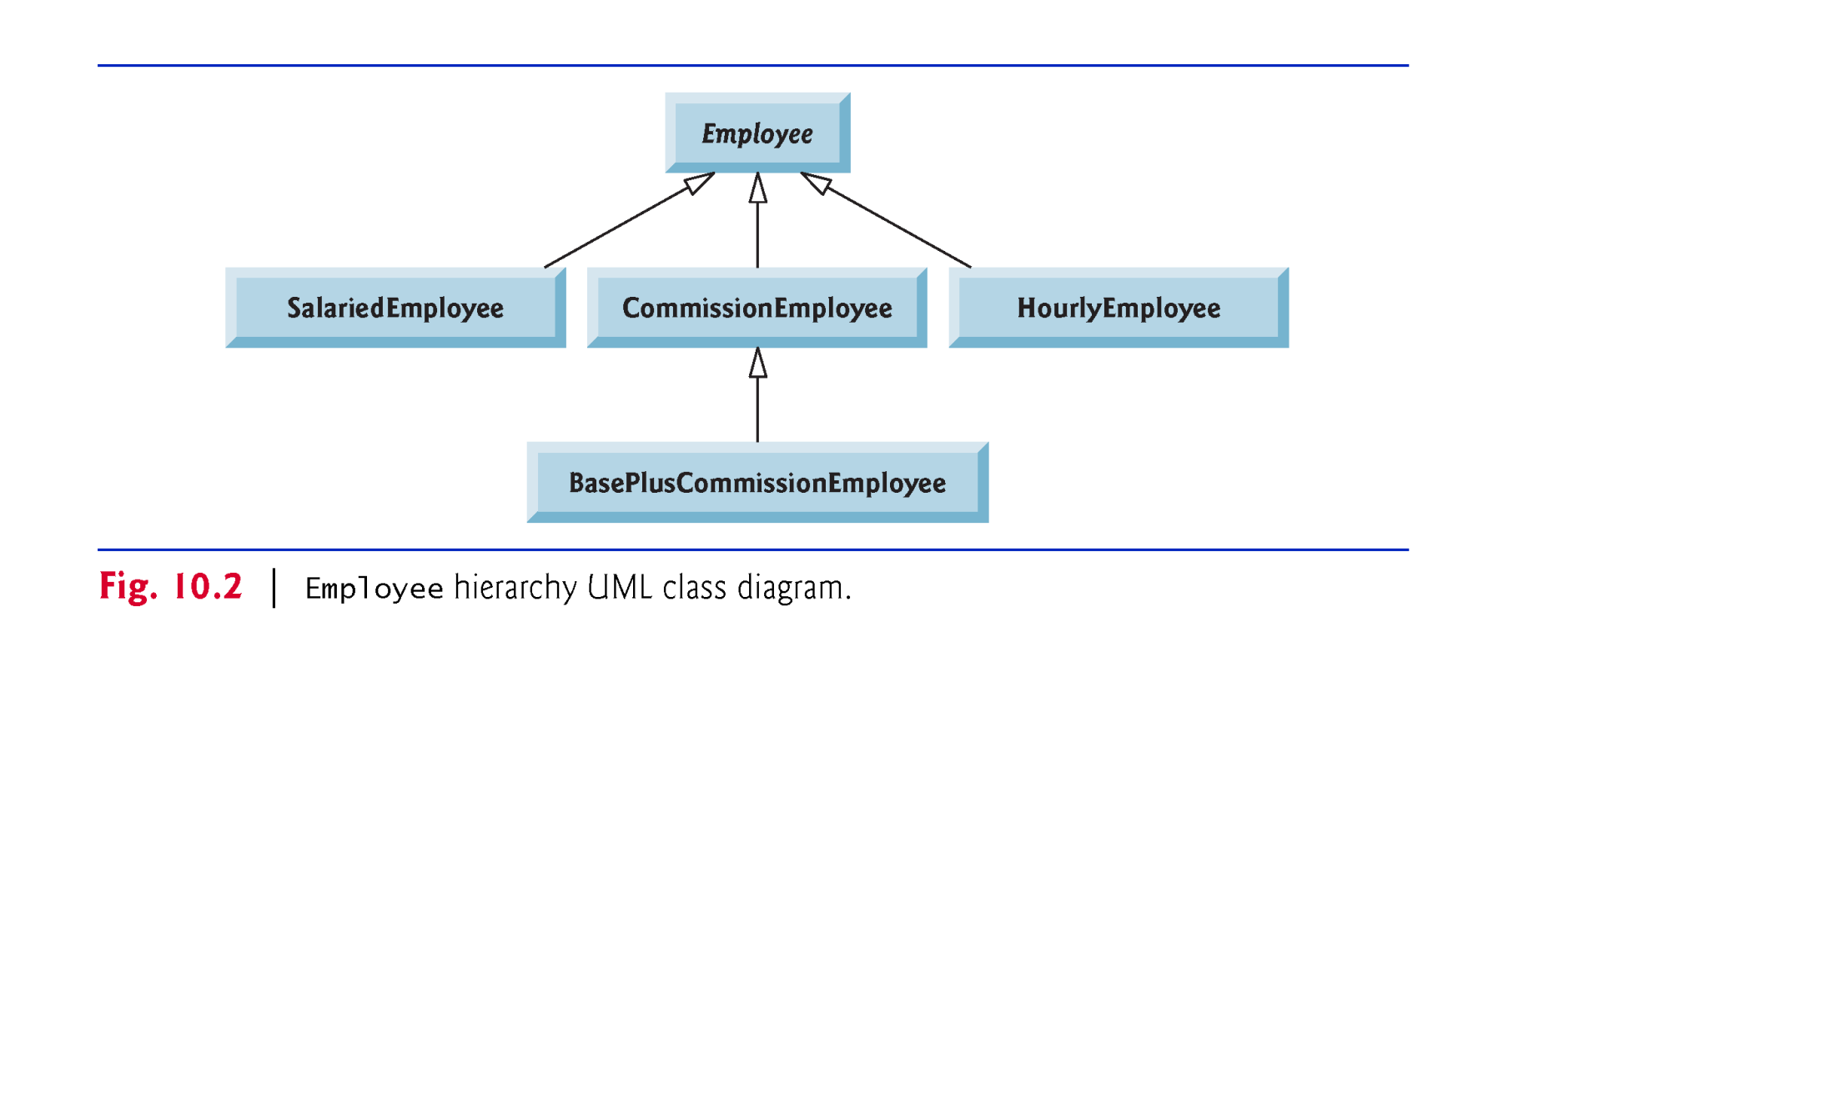
Class Diagram

Slide 6
Example 2: Payroll Application using polymorphism.
Step1: Identify abstract and concrete classes from class hierarchy
Step 2: identify common instance variables among subclasses
first name, last name and social security
Step 3: identify common methods among subclasses
earnings() and toString()
get() and set() for common instance variables
Step 4: from common methods, identify abstract methods
Earnings() method
Step 5: From common methods, identify overridden methods (with/without “super”)
Earnings() // empty body because it is abstract(without “super” key word)
toString () // customization for specific class(with super key word)
Step 6: Identify newly added instance variables in each subclass, then add their getter() and setter() methods (they are accessed by down casting)
Step 7: identify newly added methods in each class( they are not accessed by superclass reference, we need explicit down casting operation.

Slide 7
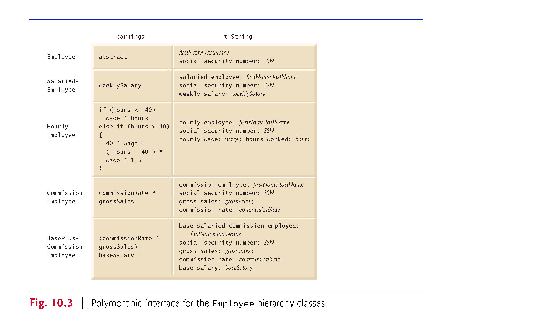
Example 2: Payroll Application using polymorphism.

Slide 8
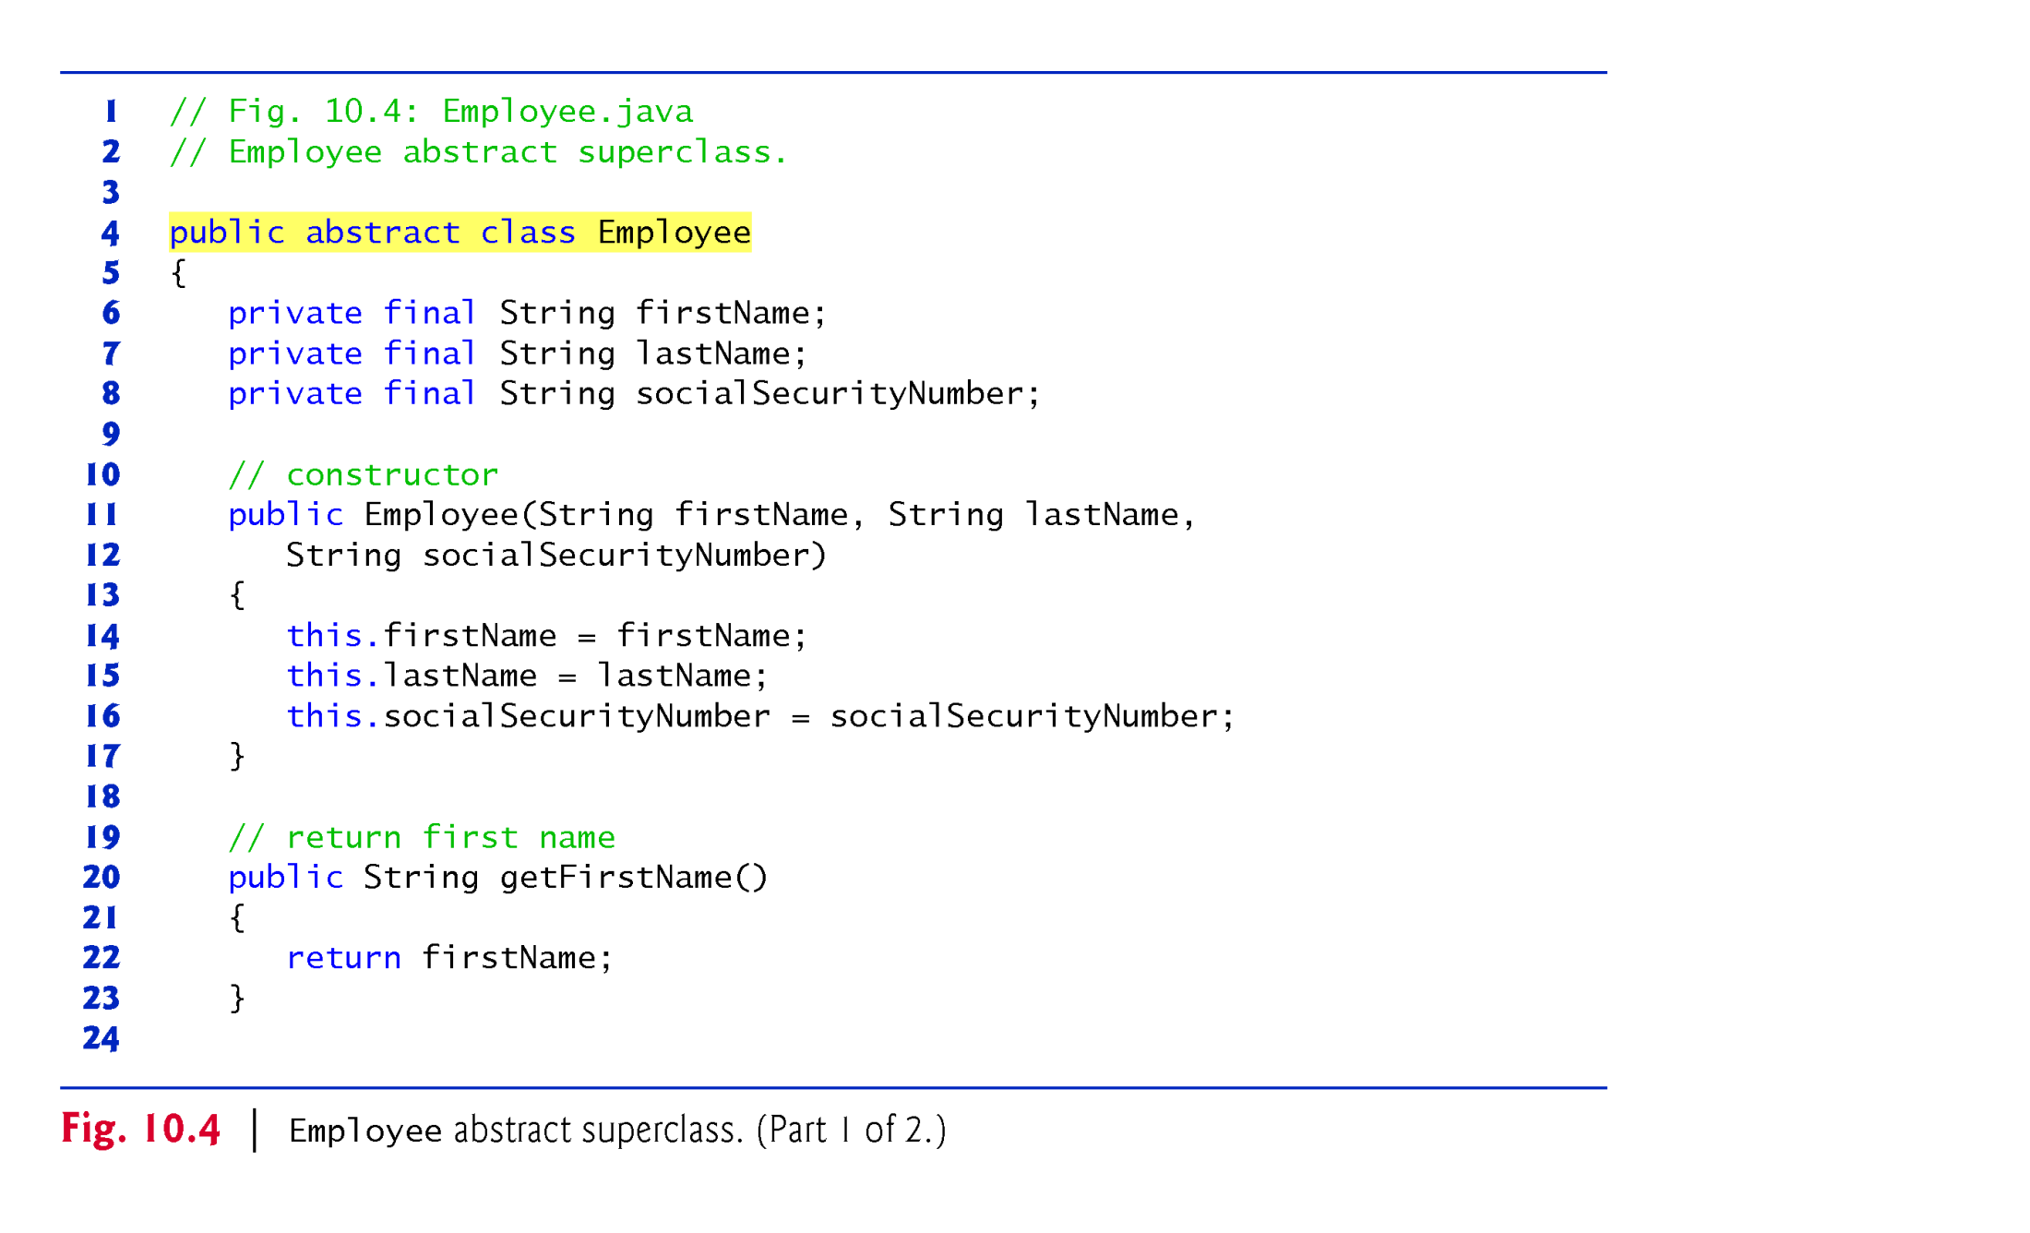
Example 2: Payroll Application using polymorphism : Parent class is abstract
but child classes are concrete: Employee (1/2)

Slide 9
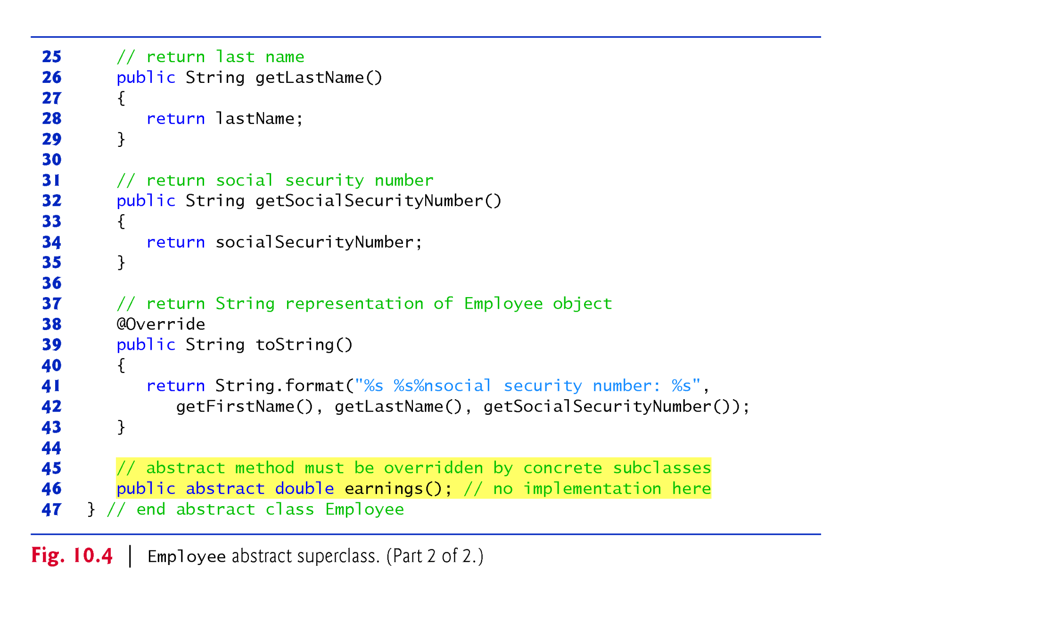
Example 2: Payroll Application using polymorphism : Parent class is abstract
but child classes are concrete: Employee (2/2)
Line 39:
Employee class override the toString() method of Object class without extending it by adding additional feature.
The toString() method of parent class is not invoked by “Super” keyword.
Line 46 makes Employee class abstract class

Slide 10
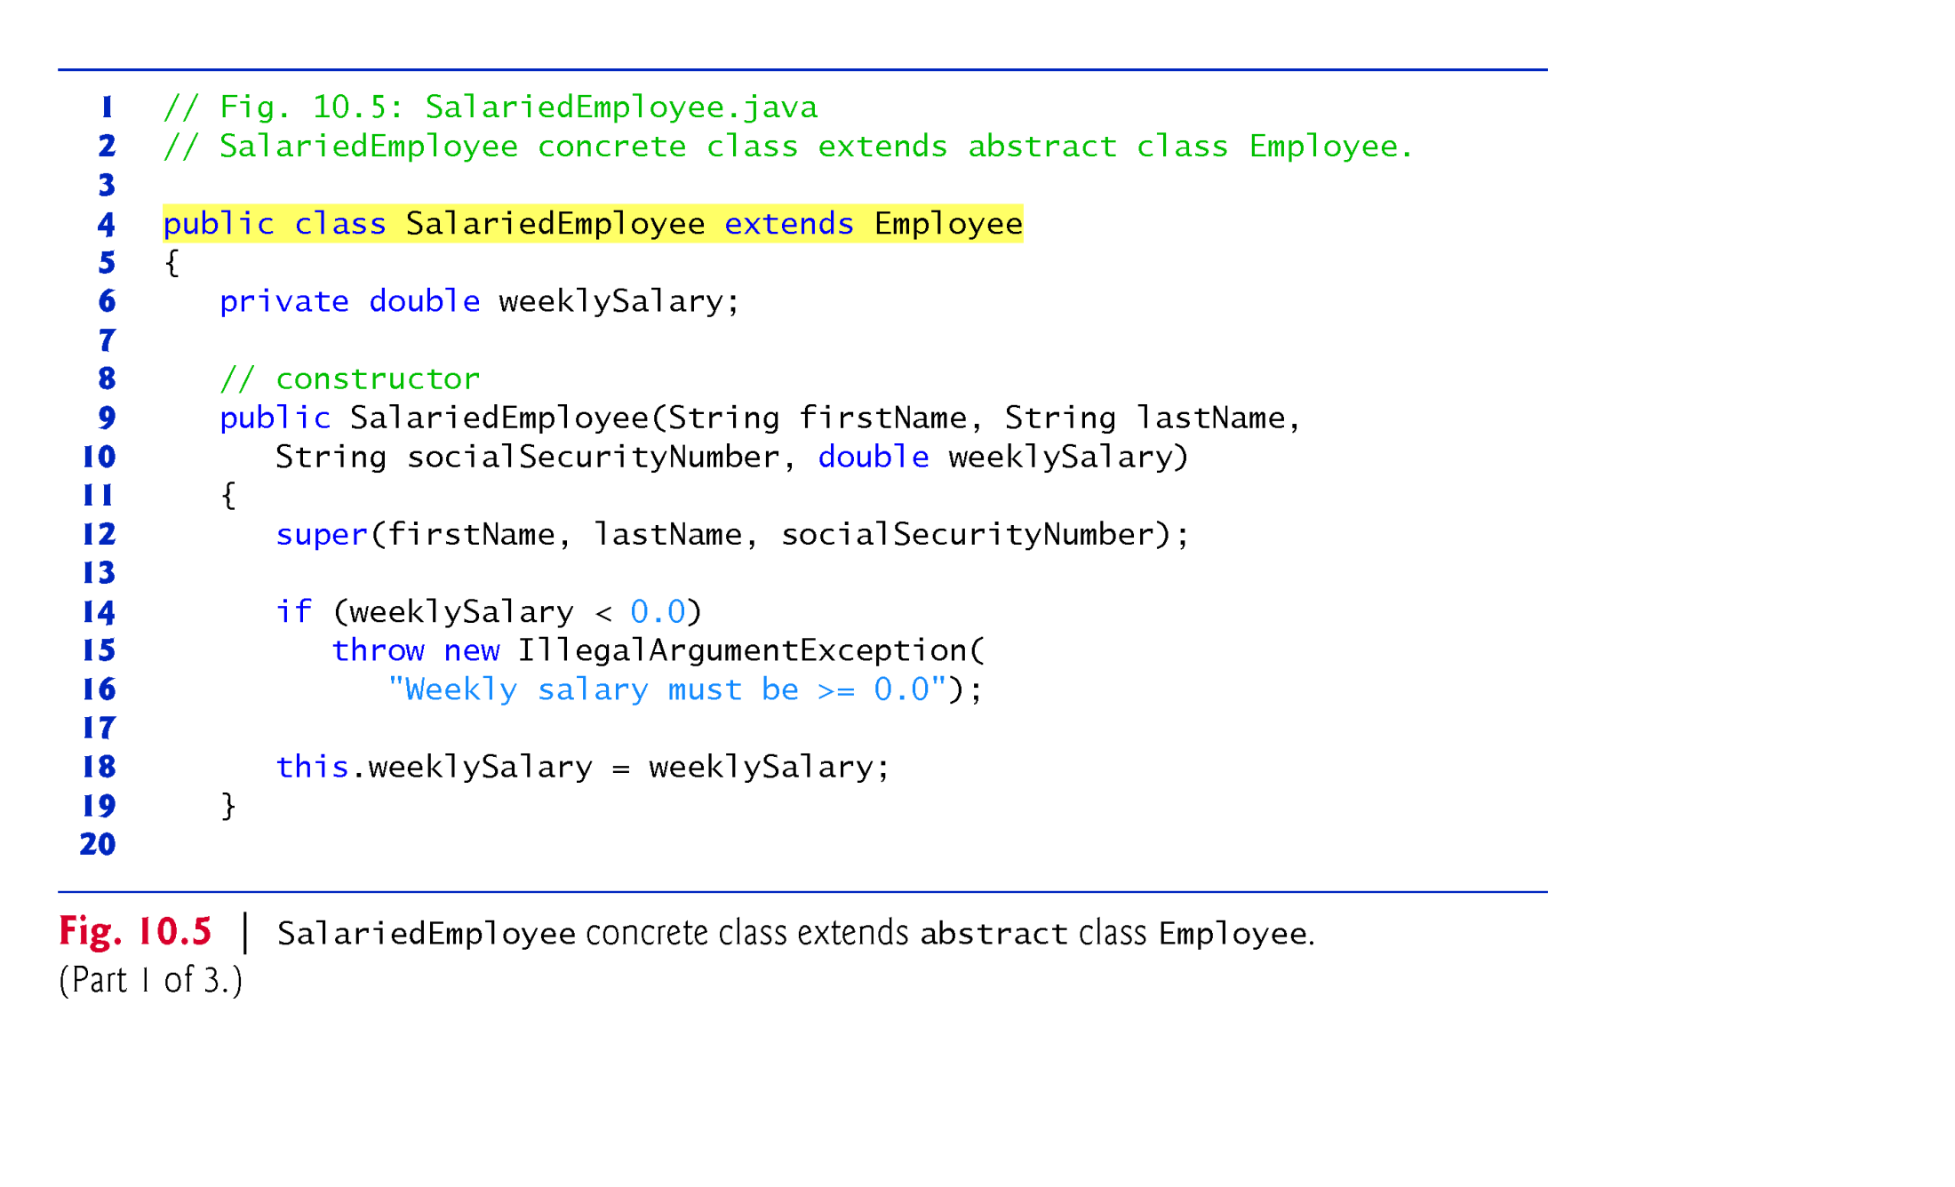
Example 2: Payroll Application using polymorphism : Parent class is abstract
but child classes are concrete: SalariedEmployee (1/3)

Slide 11
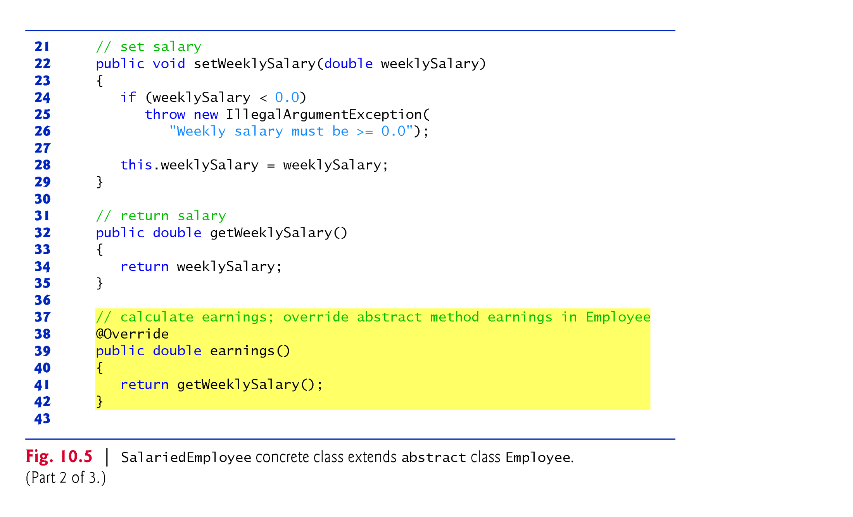
Example 2: Payroll Application using polymorphism : Parent class is abstract
but child classes are concrete: SalariedEmployee (2/3)
Line 39:
SalariedEmployee class override earnings() method of Employee class by writing its empty body.
Earnings() method of superclass will not be invoked by super keyword.

Slide 12
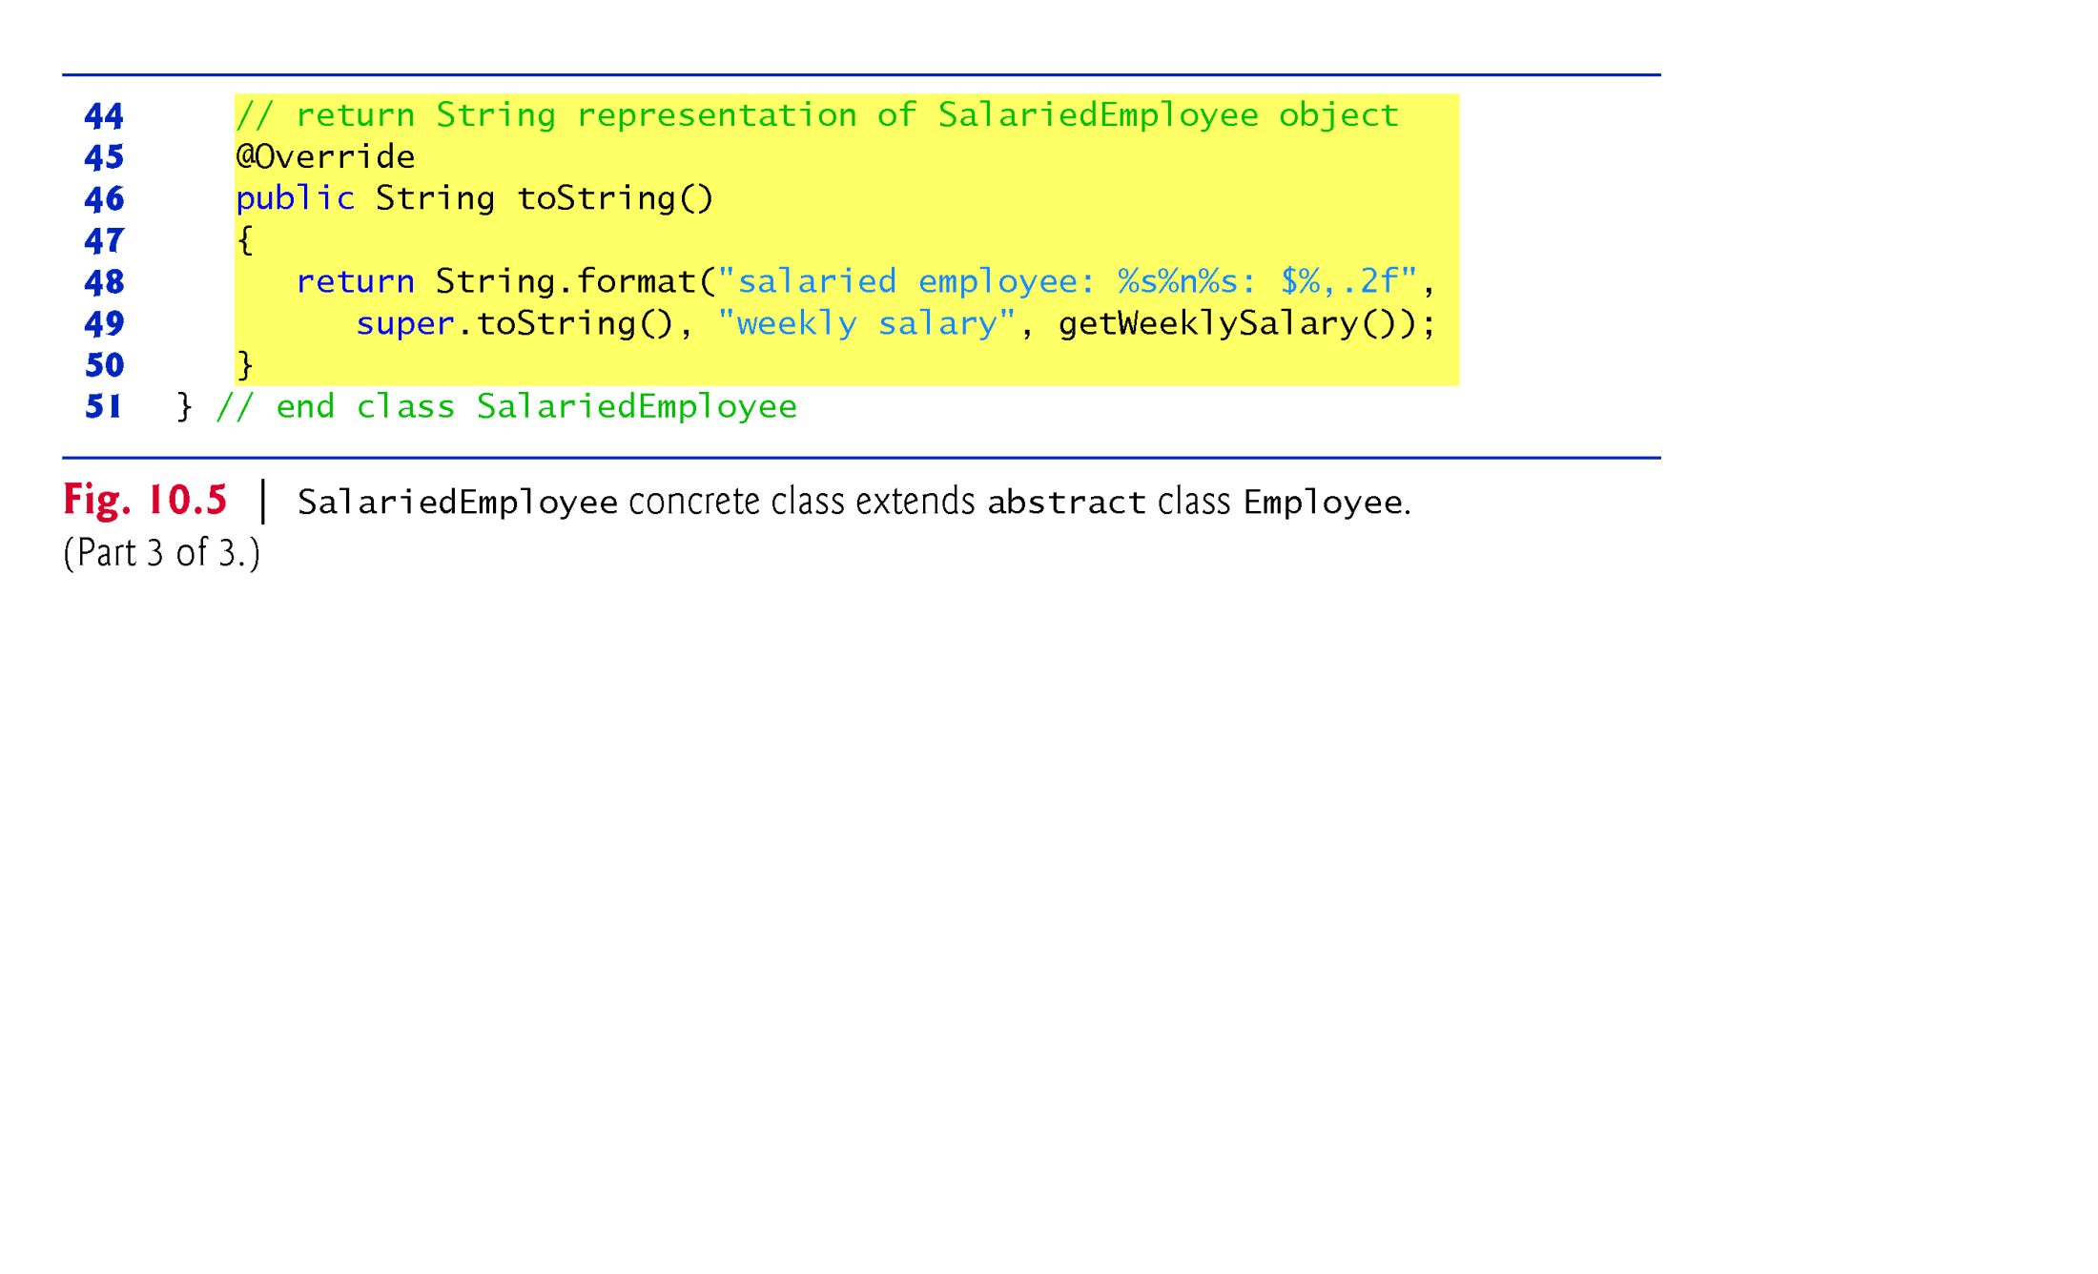
Example 2: Payroll Application using polymorphism : Parent class is abstract
but child classes are concrete: SalariedEmployee (3/3)
Line 46:
SalariedEmployee class override the toString() method of Employee class in the expanded form by adding getWeeklySalary() method.
Hence, the toString() method of parent class is invoked by “Super” keyword at line 49.

Slide 13
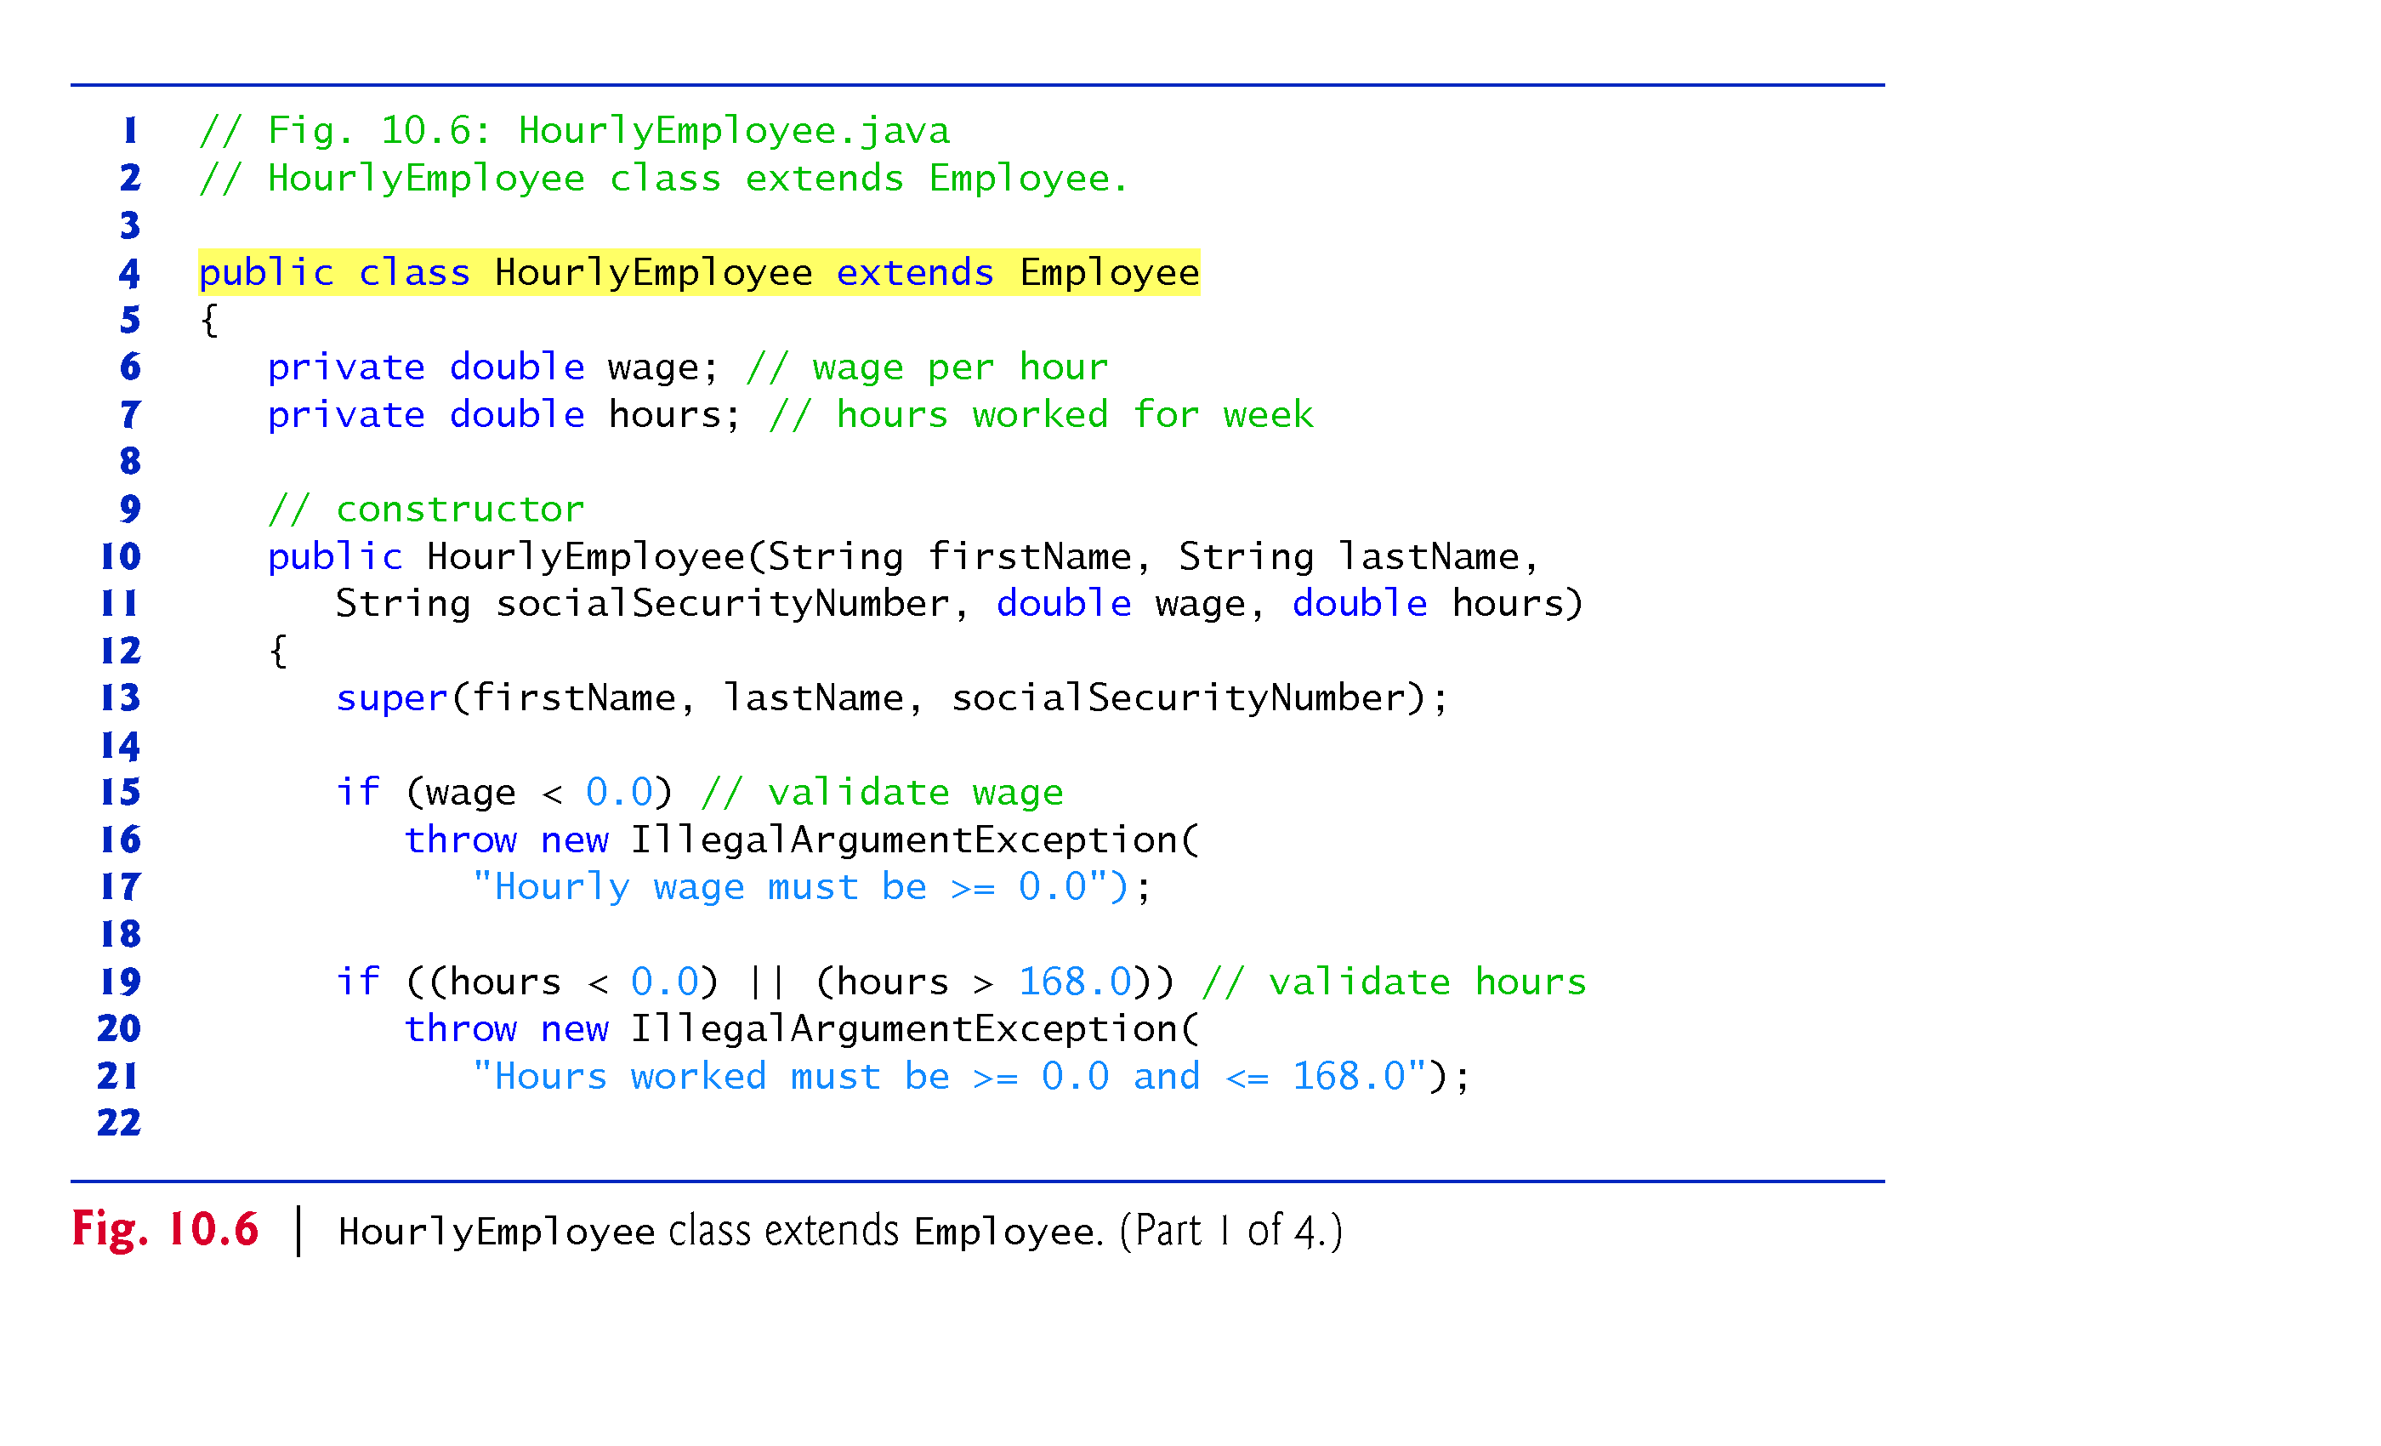
Example 2: Payroll Application using polymorphism : Parent class is abstract
but child classes are concrete: HourlyEmployee (1/4)

Slide 14
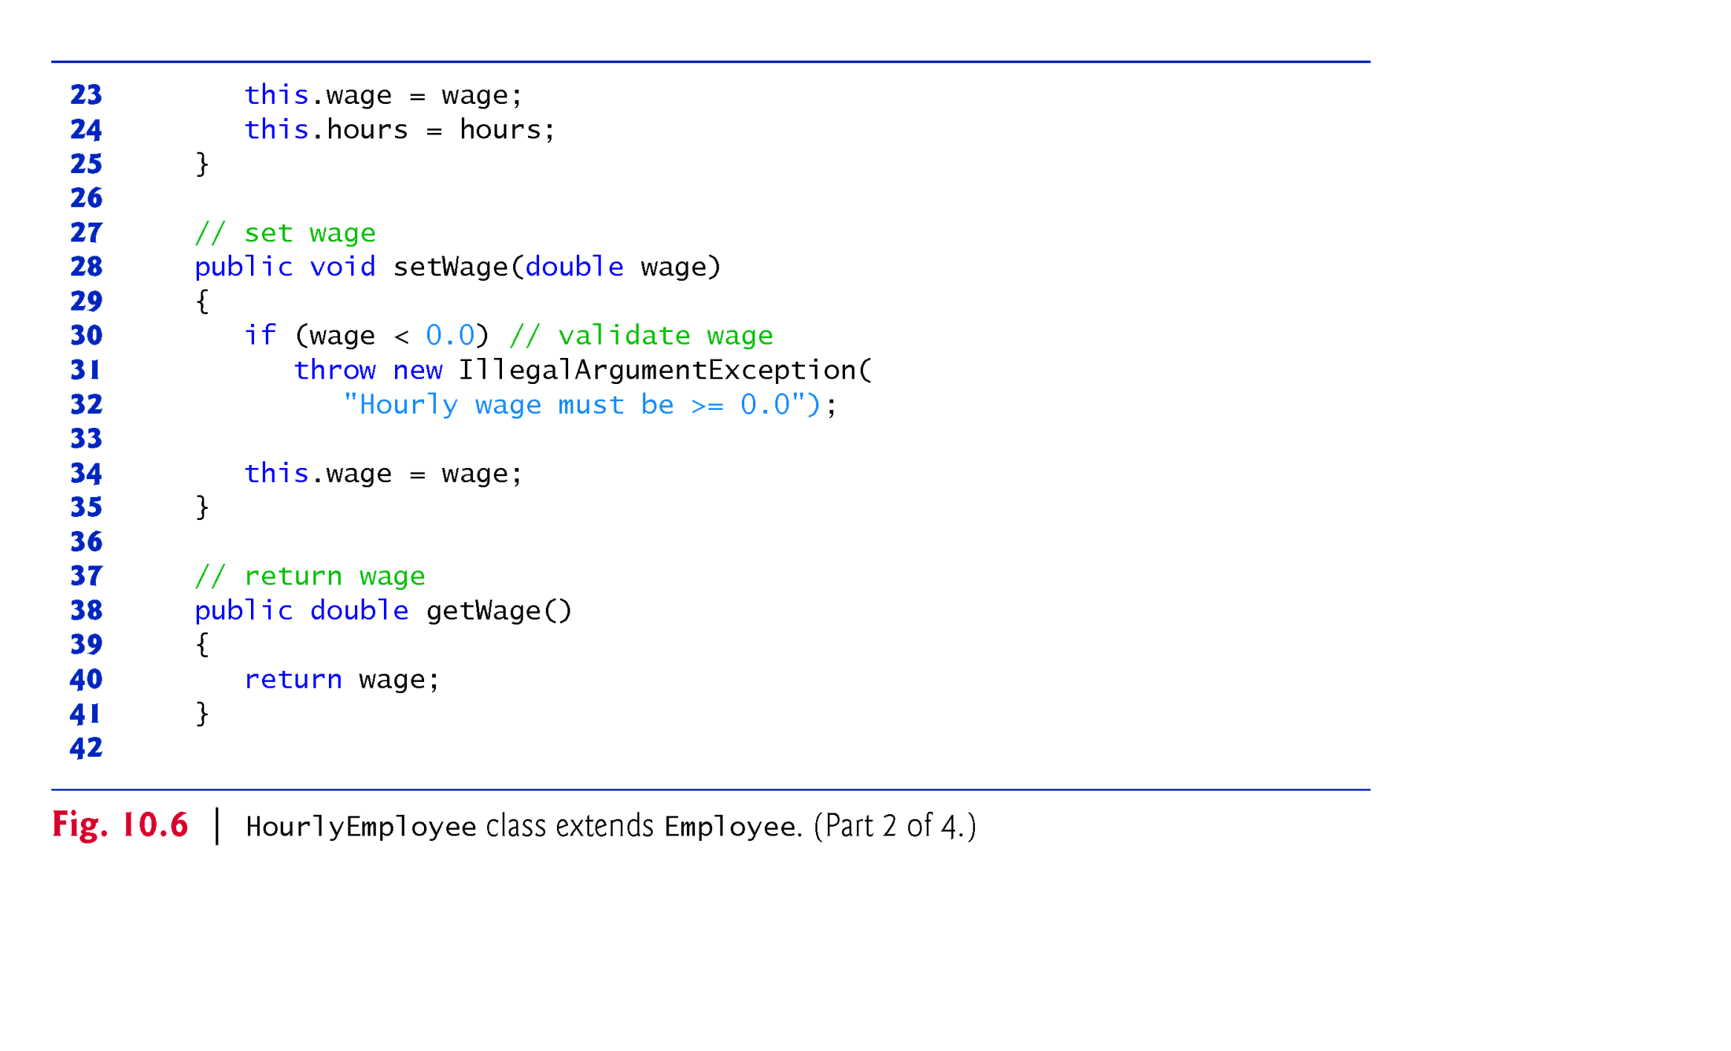
Example 2: Payroll Application using polymorphism : Parent class is abstract
but child classes are concrete: HourlyEmployee (2/4)

Slide 15
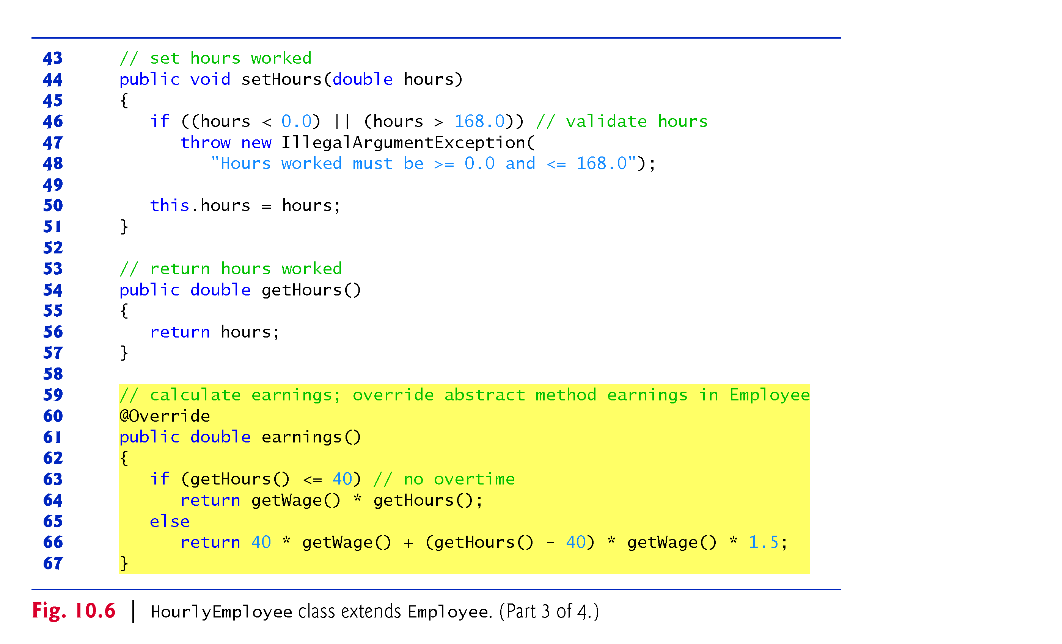
Example 2: Payroll Application using polymorphism : Parent class is abstract
but child classes are concrete: HourlyEmployee (3/4)

Slide 16
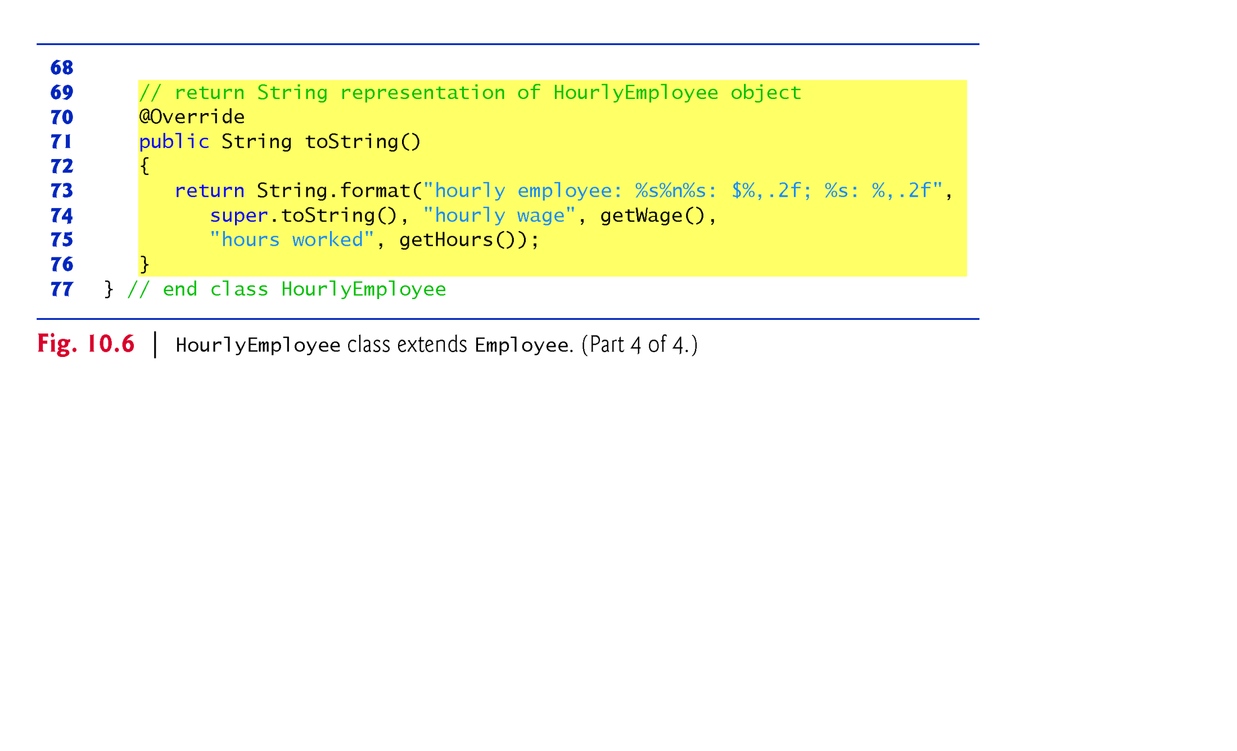
Example 2: Payroll Application using polymorphism : Parent class is abstract
but child classes are concrete: HourlyEmployee (4/4)

Slide 17
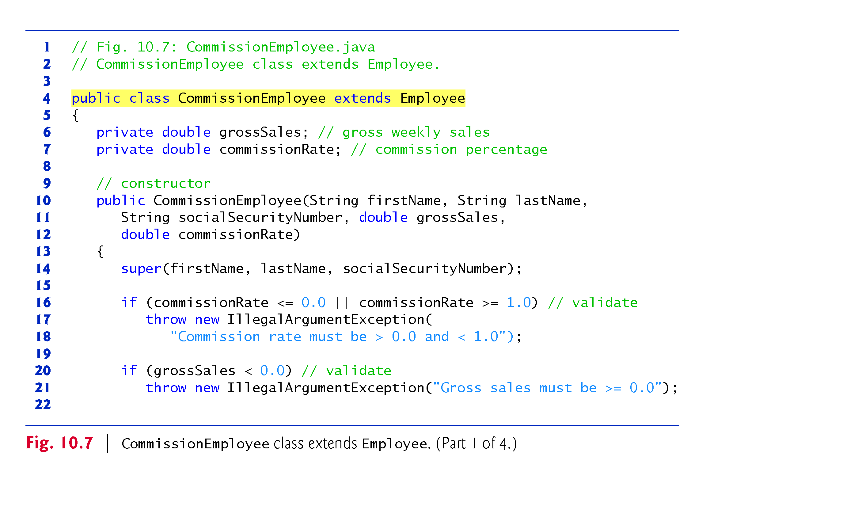
Example 2: Payroll Application using polymorphism : Parent class is abstract
but child classes are concrete: CommissionEmployee (1/4)

Slide 18
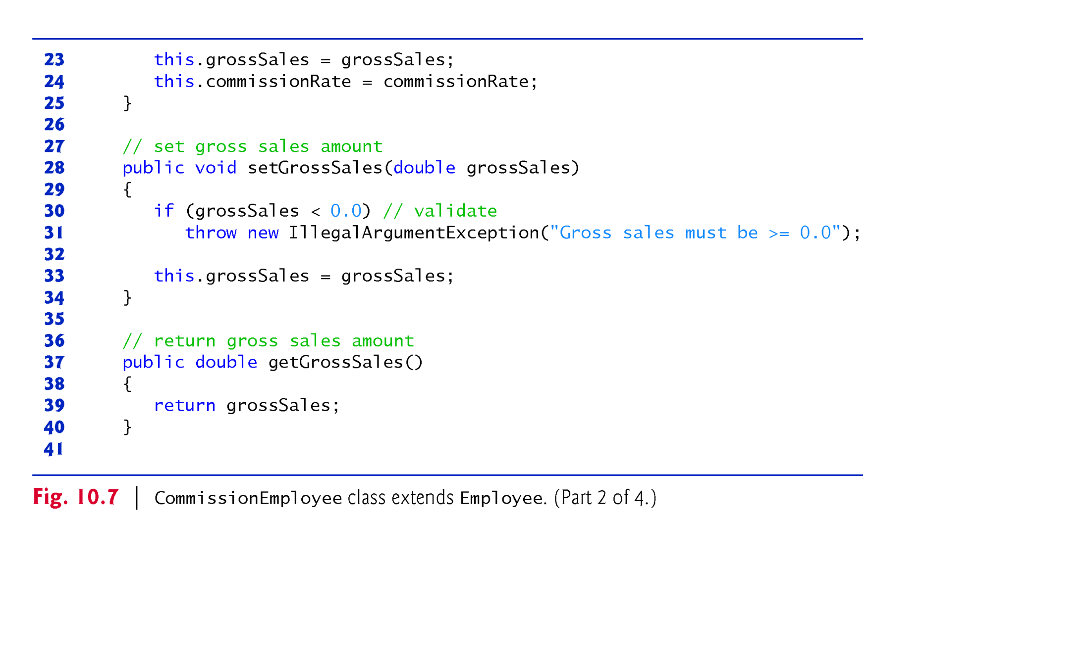
Example 2: Payroll Application using polymorphism : Parent class is abstract
but child classes are concrete: CommissionEmployee (2/4)

Slide 19
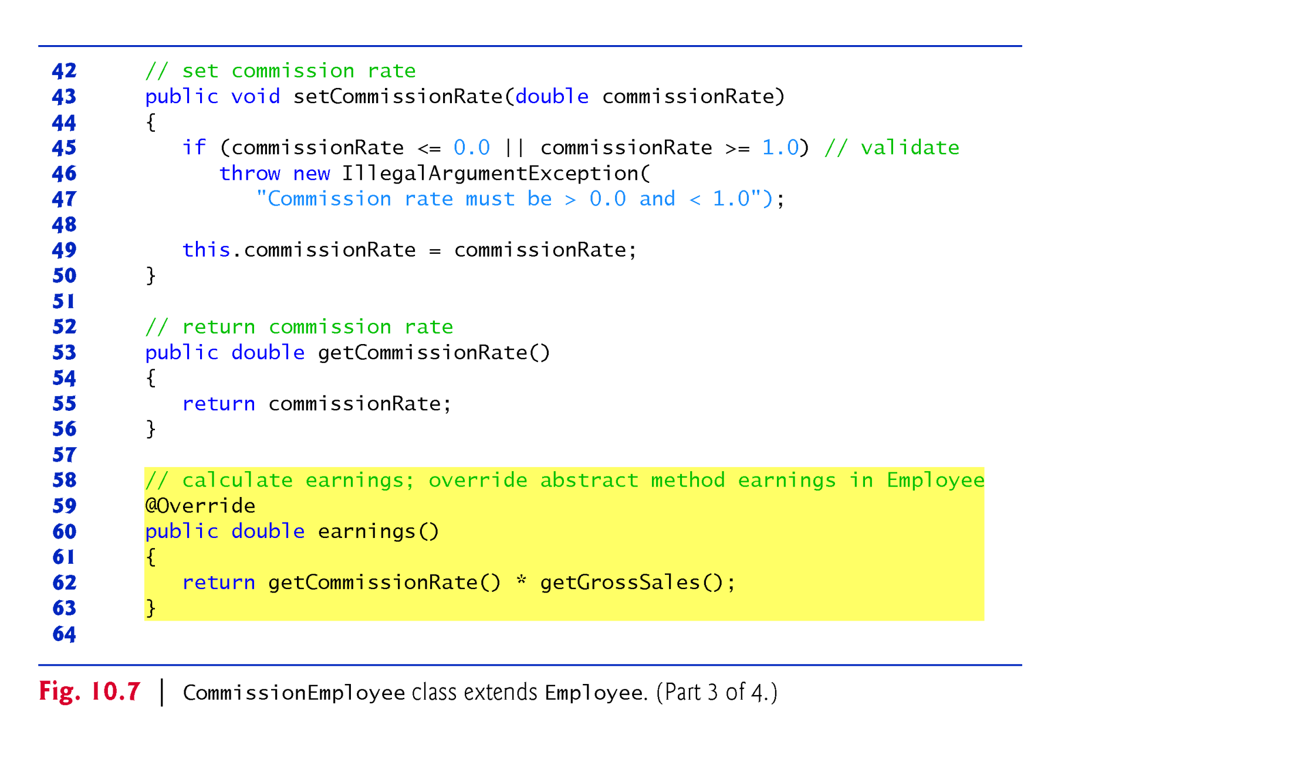
Example 2: Payroll Application using polymorphism : Parent class is abstract
but child classes are concrete: CommissionEmployee (3/4)

Slide 20
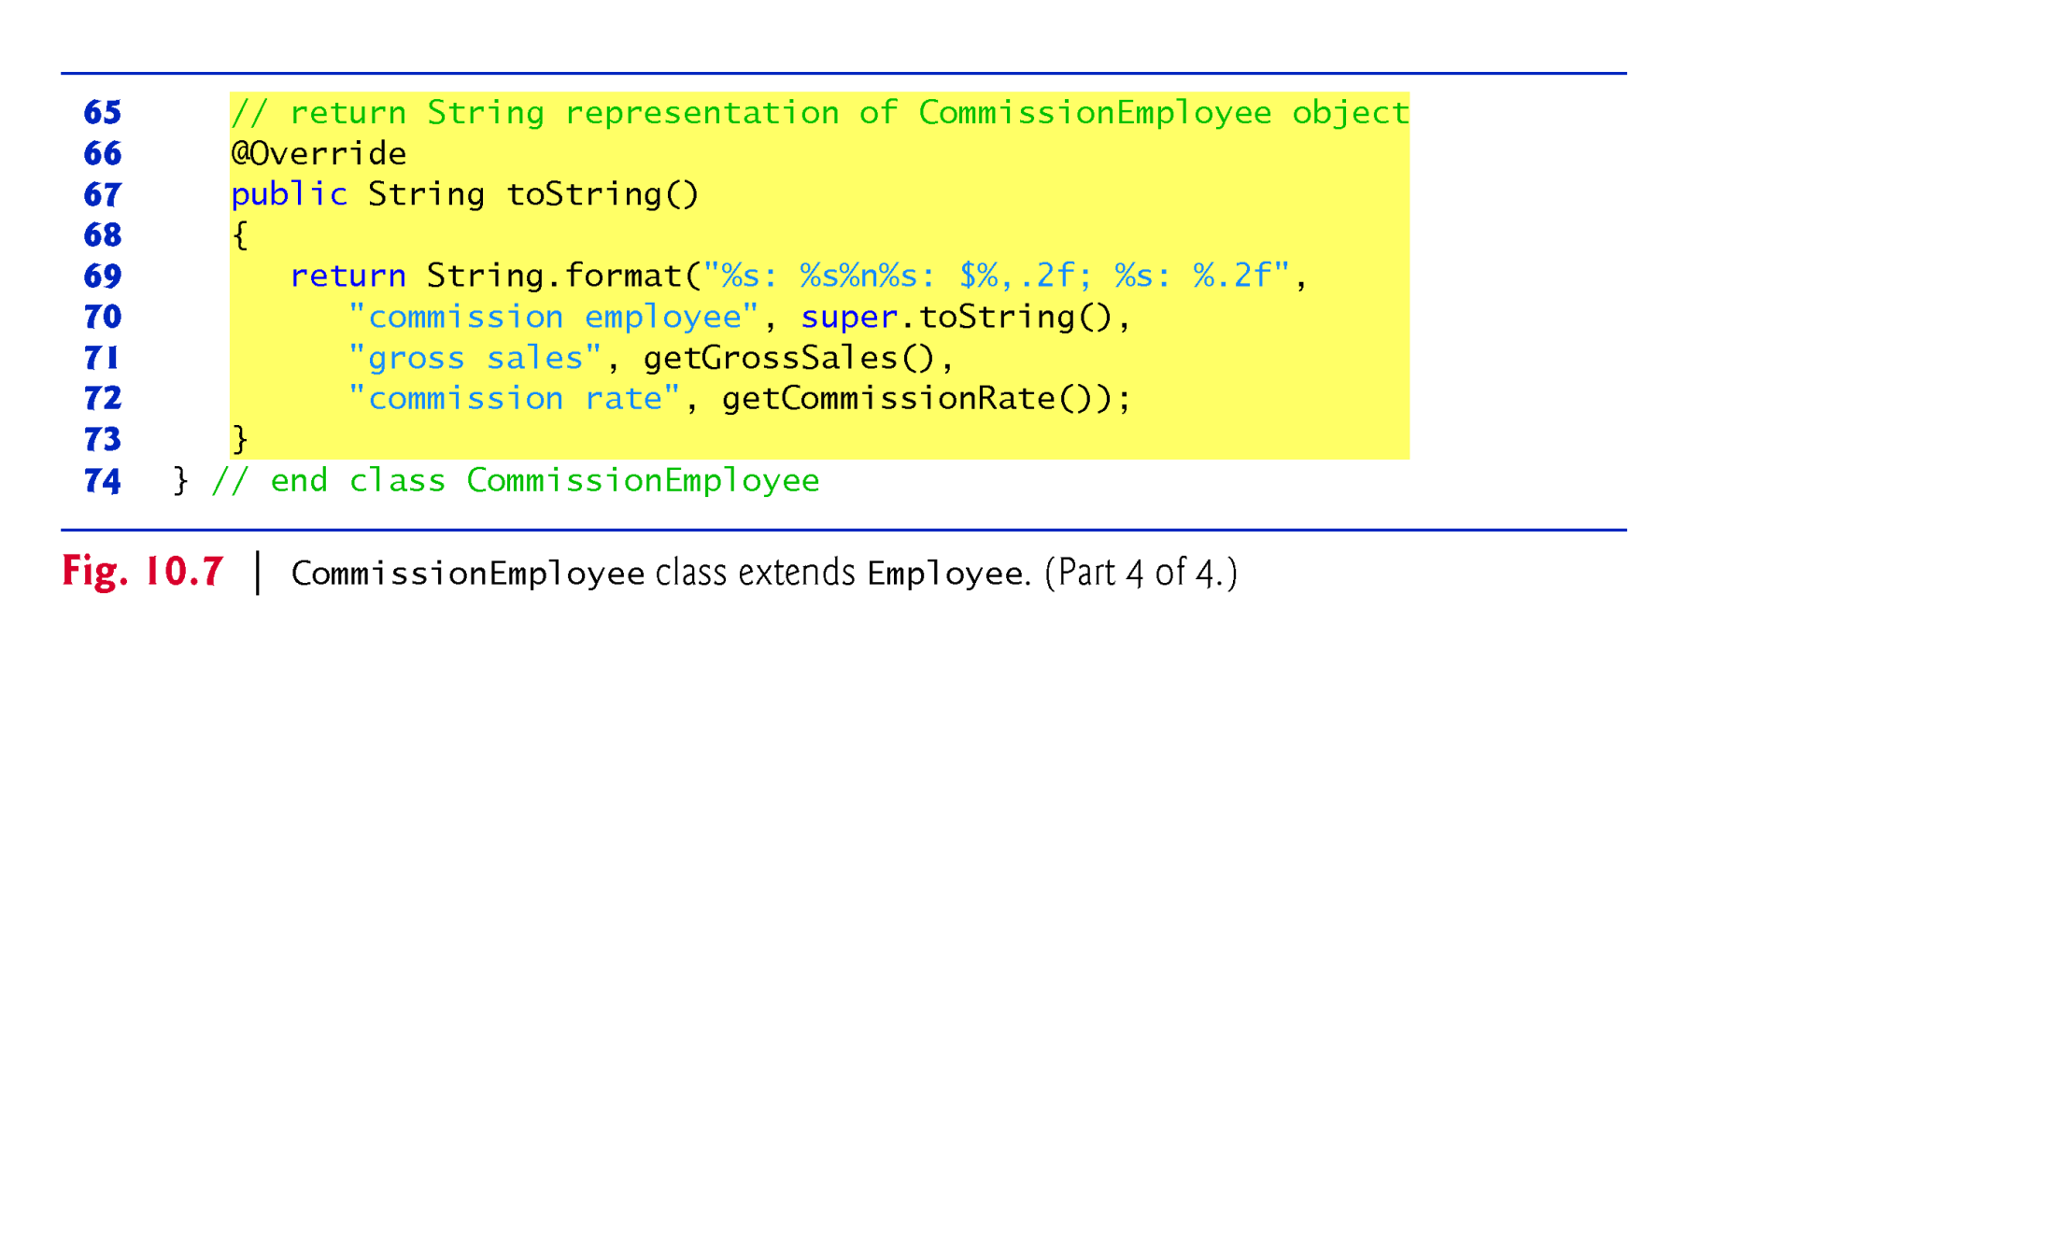
Example 2: Payroll Application using polymorphism : Parent class is abstract
but child classes are concrete: CommissionEmployee (4/4)

Slide 21
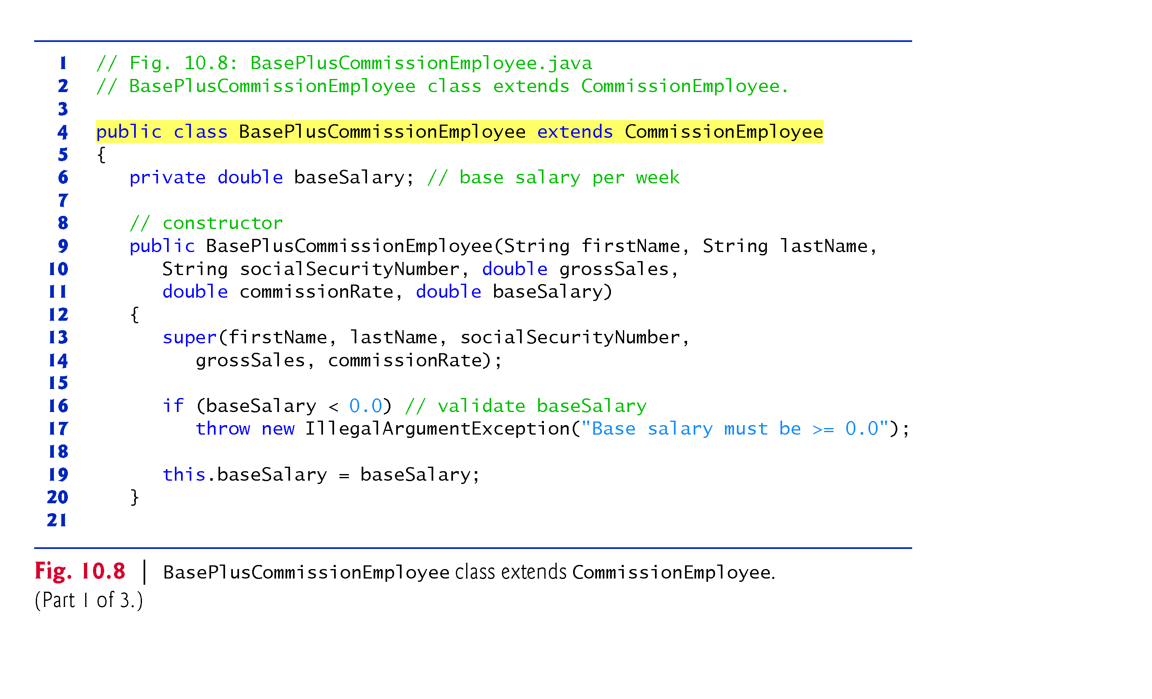
Example 2: Payroll Application using polymorphism : Parent class is abstract
but child classes are concrete: BaseplusCommissionEmployee (1/3)

Slide 22
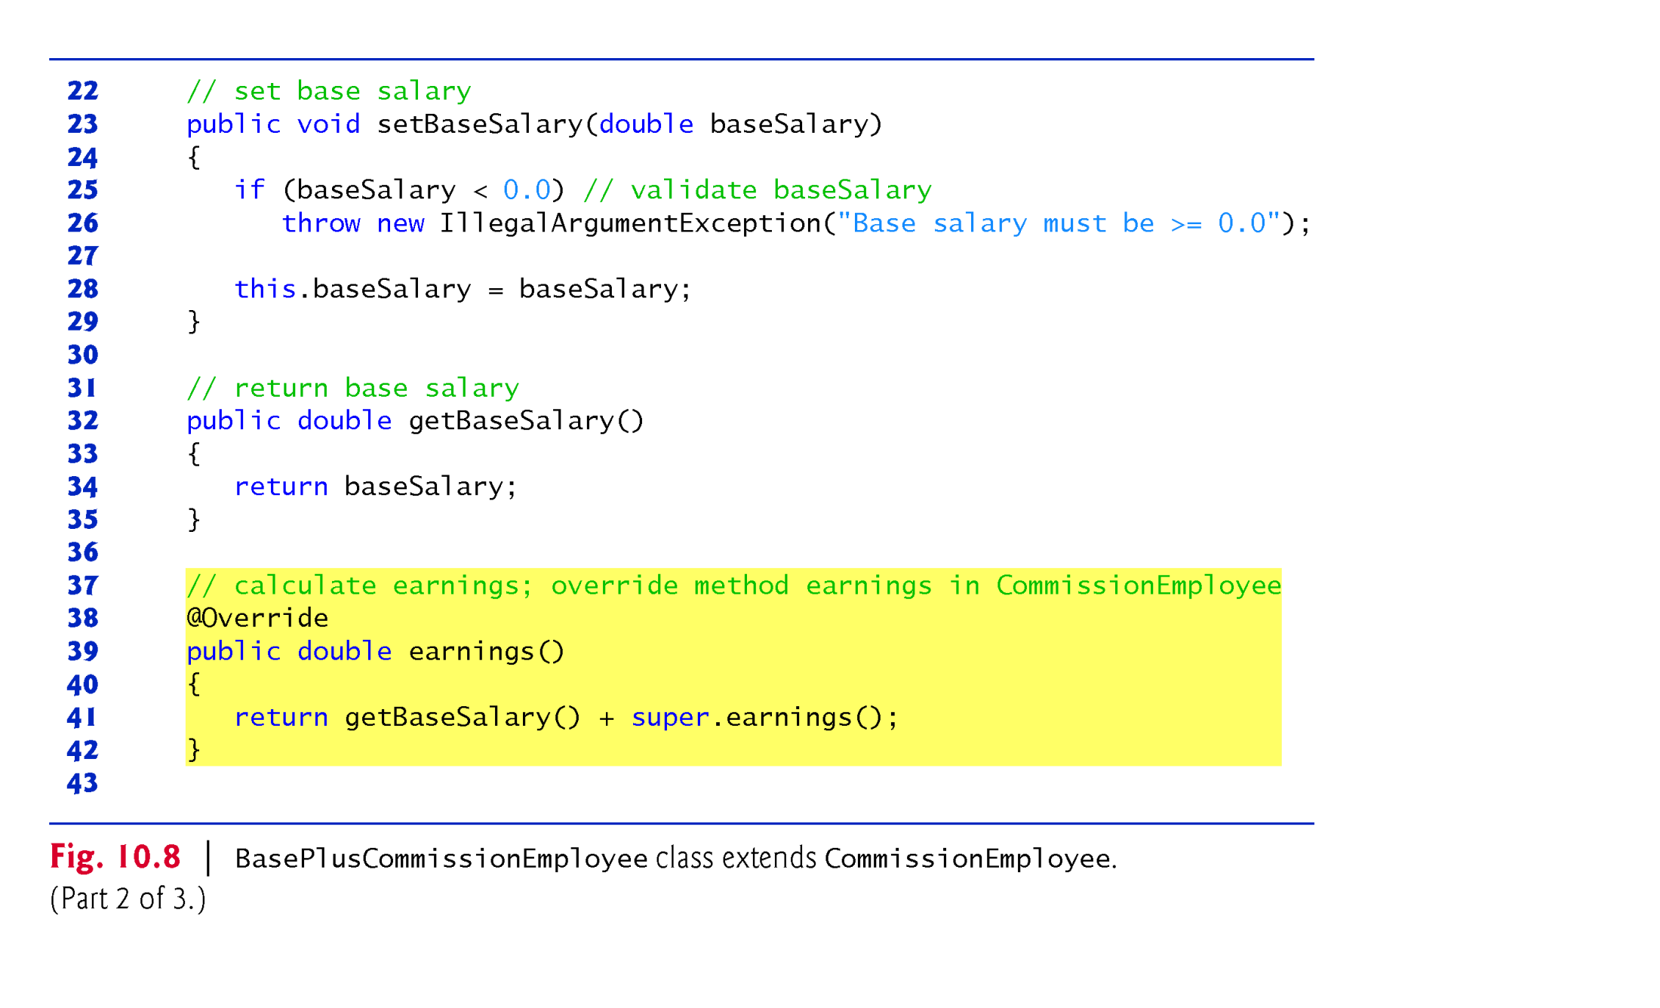
Example 2: Payroll Application using polymorphism : Parent class is abstract
but child classes are concrete: BaseplusCommissionEmployee (2/3)
Line 39: earnings() method is overridden in expanded form by adding the getBaseSalary() method. Hence, earning() of supper class is invoked via “super”

Slide 23
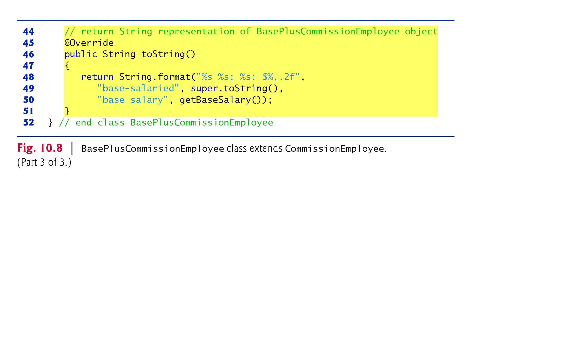
Example 2: Payroll Application using polymorphism : Parent class is abstract
but child classes are concrete: BaseplusCommissionEmployee (3/3)
Line 46: toString() method of the supperclass is overridden in expanded form by adding the getBaseSalary() method. Hence, toString() method of supper class is invoked via “super”

Slide 24
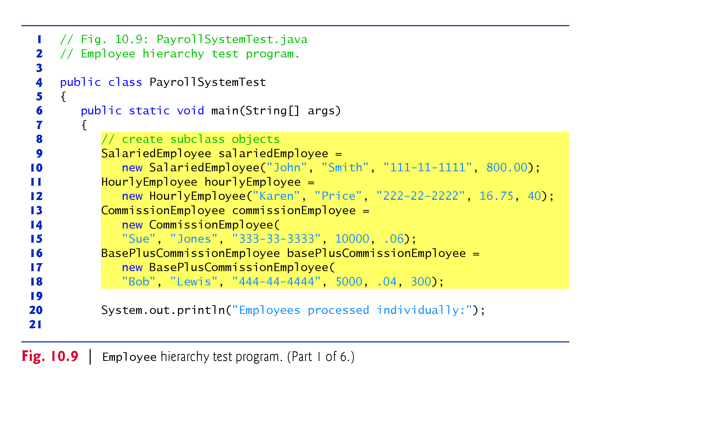
Example 2: Payroll Application using polymorphism : Parent class is abstract
but child classes are concrete: payrollSystemTest (1/6)
Line 9-30: non-polymorphism implementation.

Slide 25
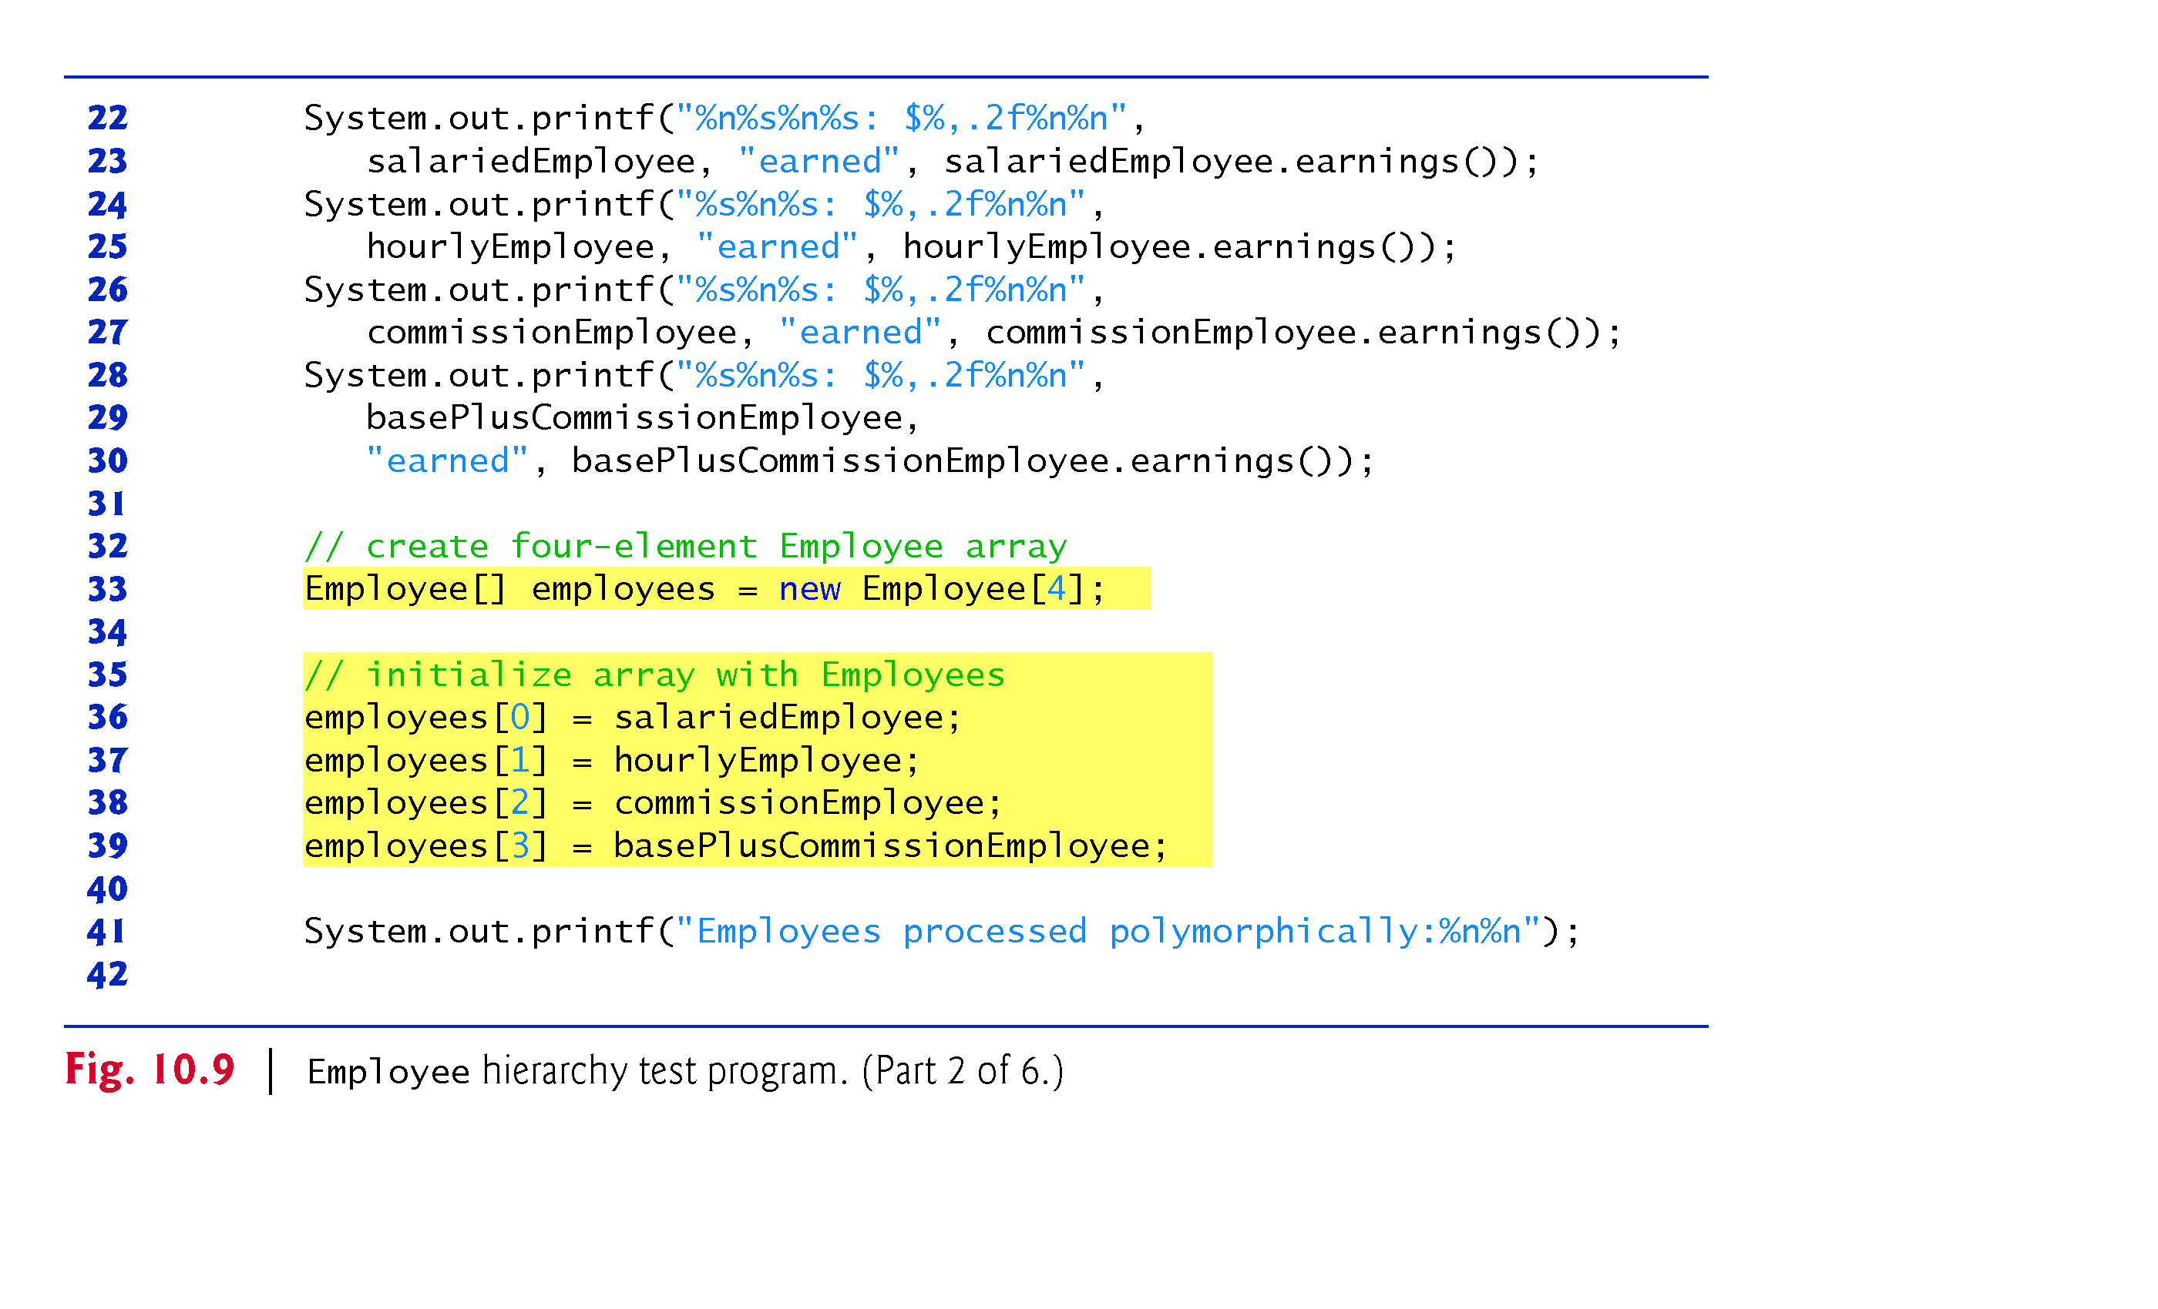
Example 2: Payroll Application using polymorphism : Parent class is abstract
but child classes are concrete: payrollSystemTest (2/6)
Line 23: salariedEmployee can be replaced by alariedEmployee.toString()
Line 33-72: polymorphism implementation.

Slide 26
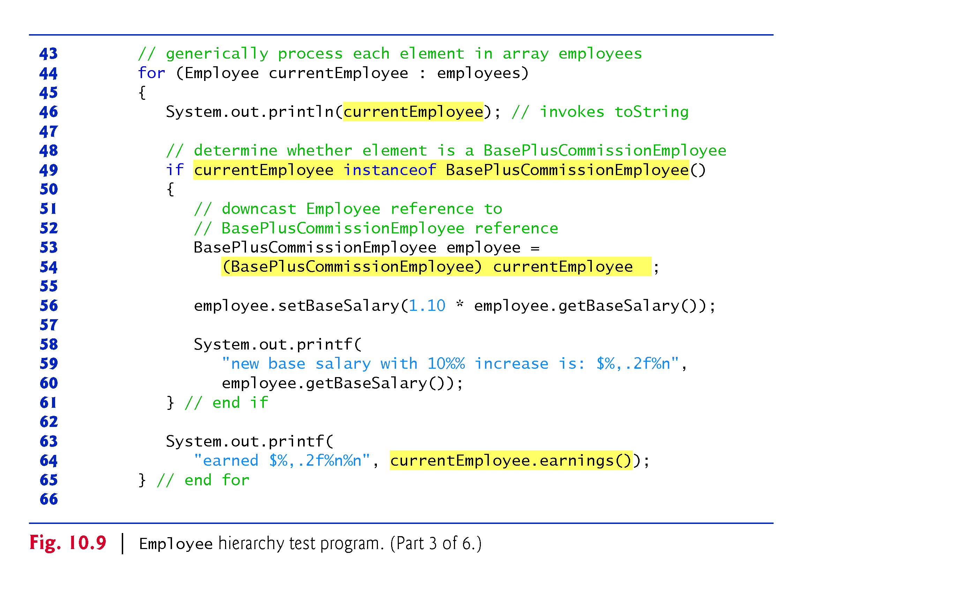
Example 2: Payroll Application using polymorphism : Parent class is abstract
but child classes are concrete: payrollSystemTest (3/6)
Line 49: Is the current object a basePlusCom object?
Yes: down casting superclass reference into subclass reference to invoke subclass specific methods
No: no casting, then invoke the common subclass methods by superclass reference
Line 46: System.out.println(currentEmployee) can be replaced by
System.out.println (currentEmployee.toString() ) ;

Slide 27
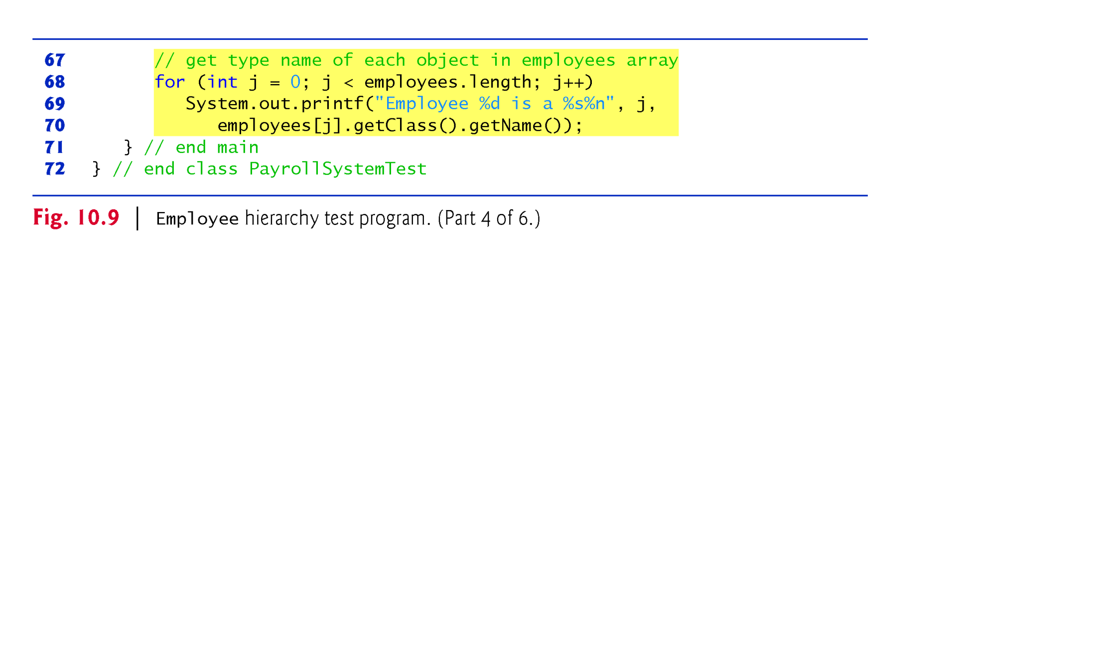
Example 2: Payroll Application using polymorphism : Parent class is abstract
but child classes are concrete: payrollSystemTest (4/6)
Line 70: package
java.lang.Class
Line 70: “Object” class has getClass()
public final Class getClass() // meta data about the class during loading
“Class” has getName() method”
public String getName()
Since every object inherits Object class, every class knows its class type by invoking its getClass() method.
Line 69-70 can be can be replaced by 3 lines as follows:
Class cRefVar = employees[j]. getClass // every object inhertit getclass().
String sRefVar = cRfeVar.getName()
System.out.printf(“Employee%d is a %s %n, j, sRefVar);

Slide 28
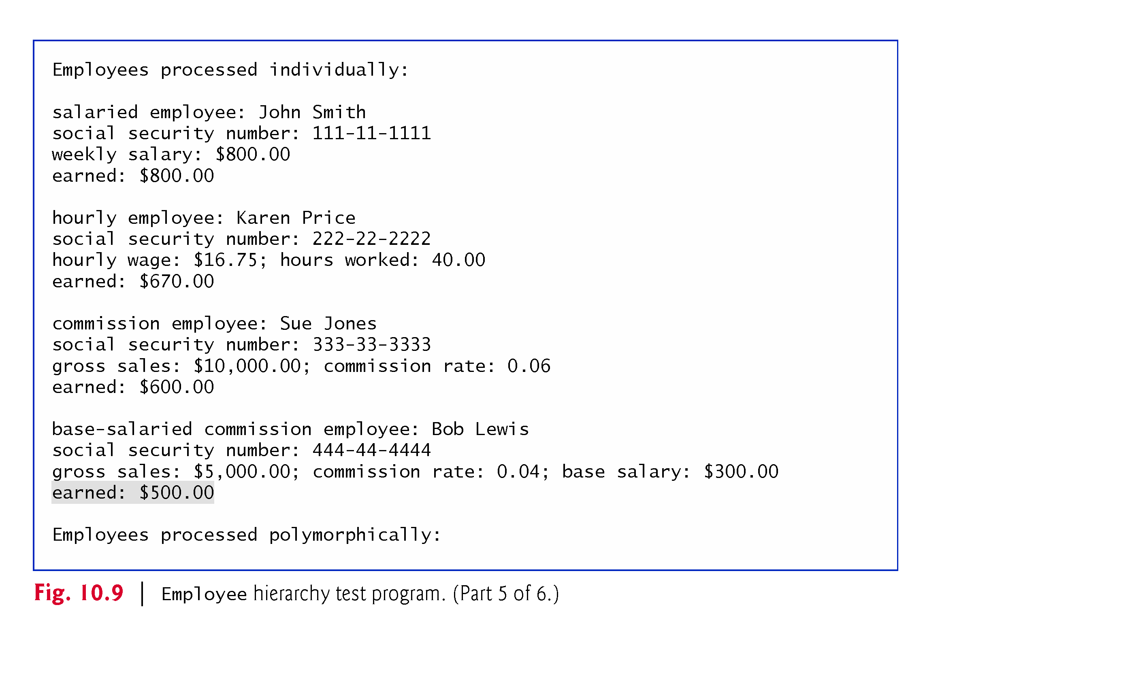
Example 2: Payroll Application using polymorphism : Parent class is abstract
but child classes are concrete: payrollSystemTest (5/6)

Slide 29
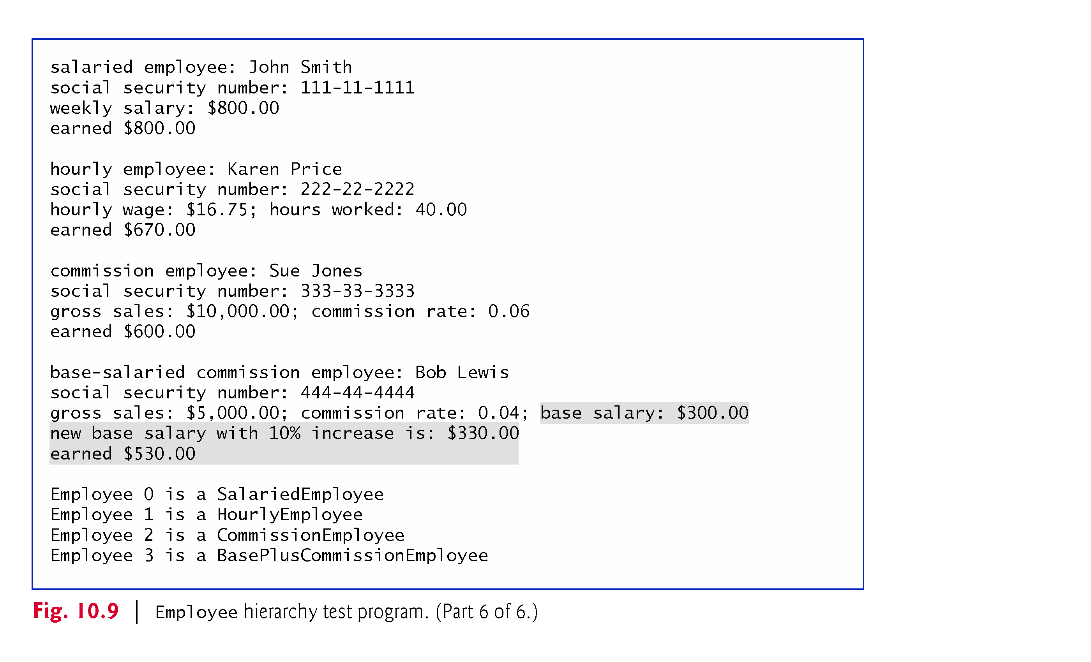
Example 2: Payroll Application using polymorphism : Parent class is abstract
but child classes are concrete: payrollSystemTest (6/6)

Slide 30
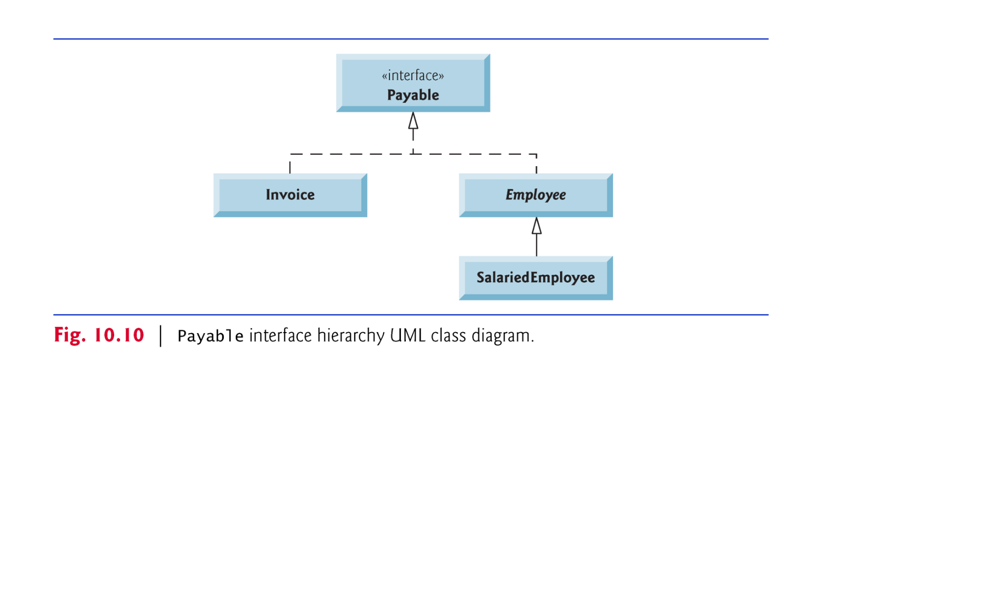
Example 3: Paymnet Application to Employees and Invoices using polymorphism : Parent class is Interface but child classes are concrete
Object
implements
Concrete class
Abstract class
(italic)
Concrete class
The UML expresses the relationship between a class and an interface through a implementaion

Slide 31
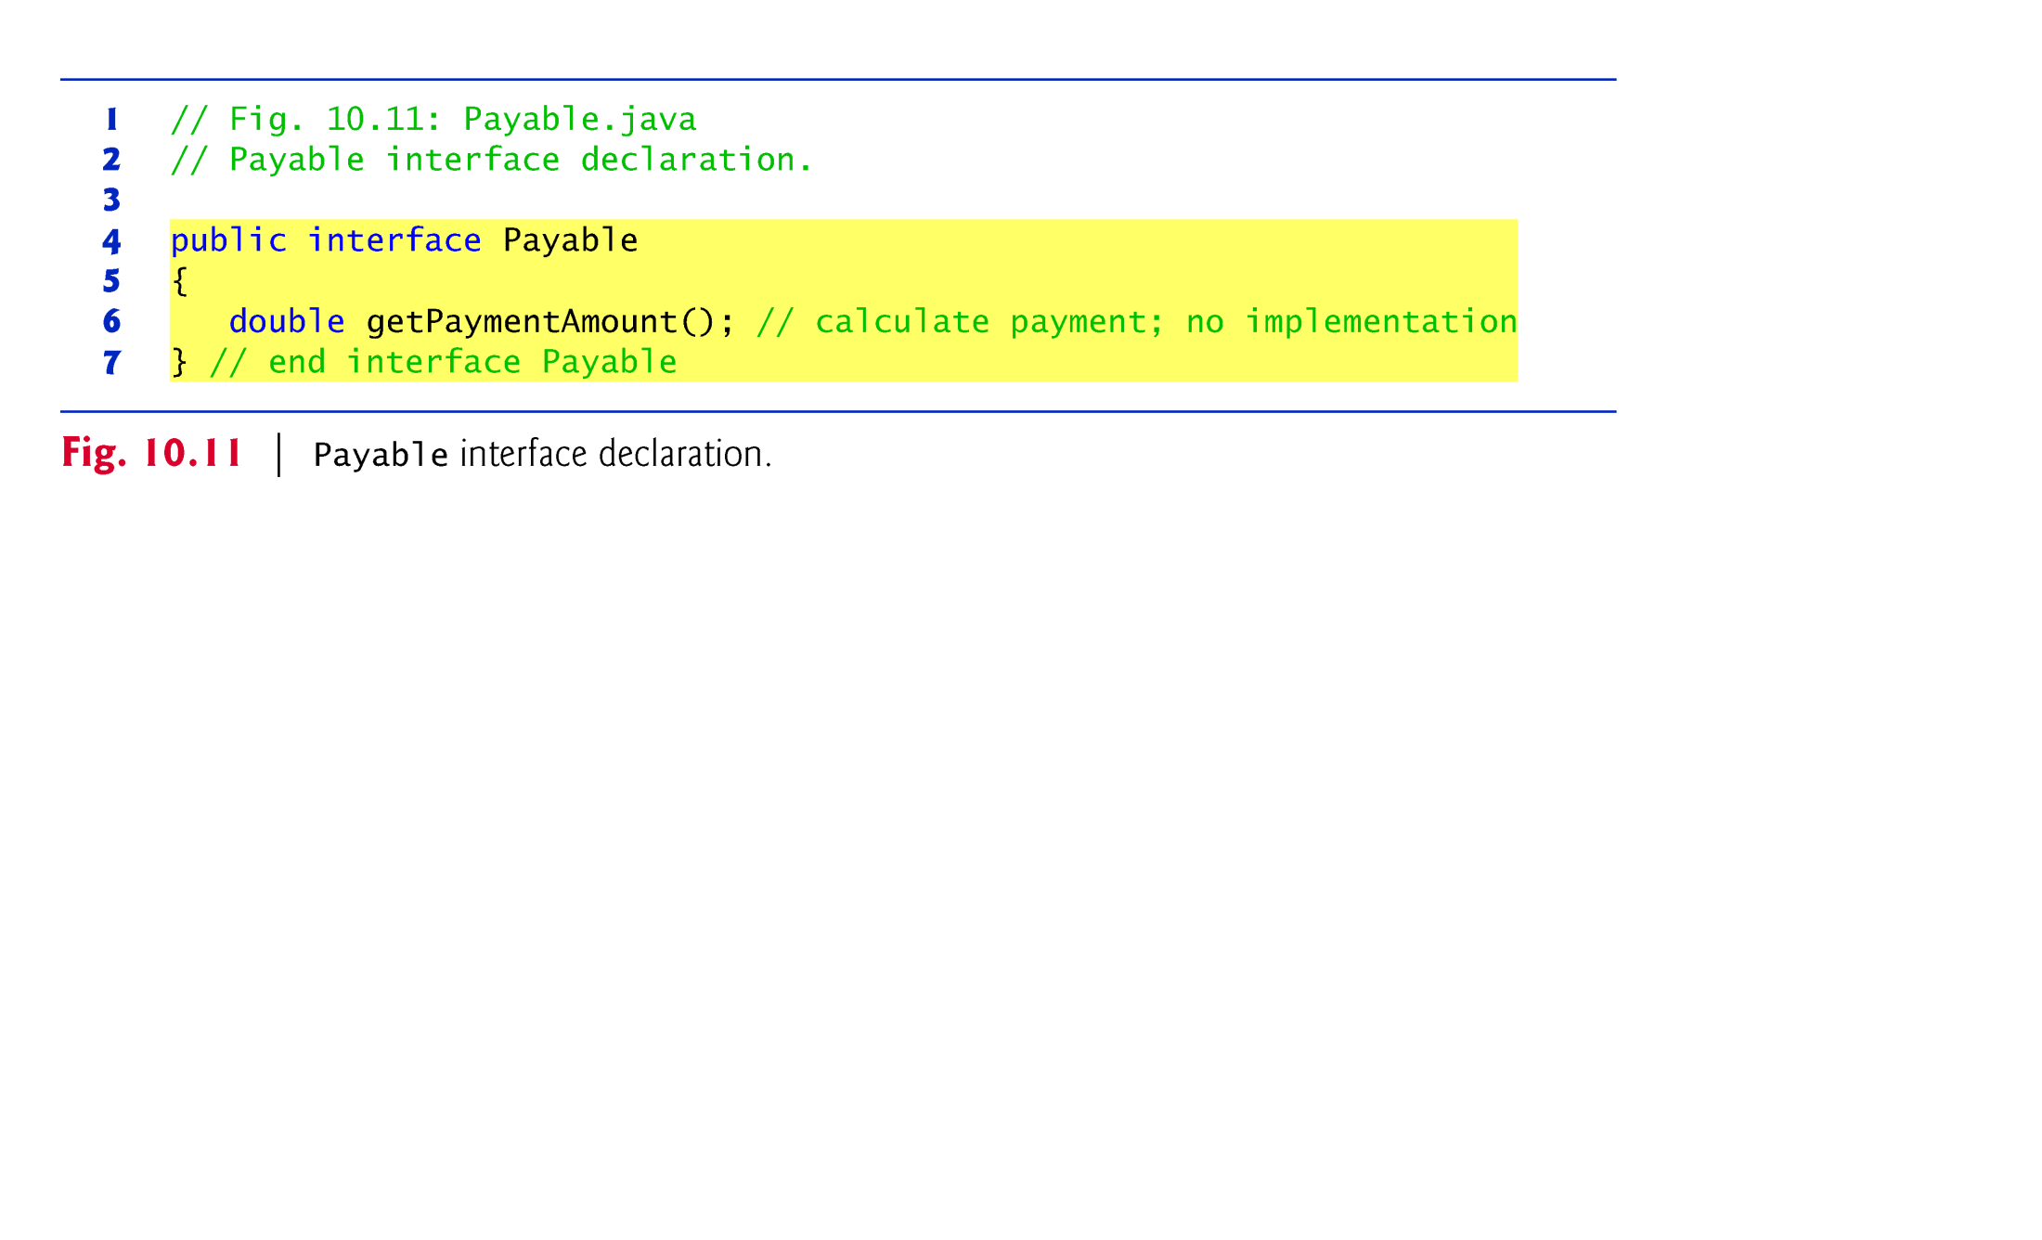
Example 3: Paymnet Application to Employees and Invoices using polymorphism : Parent class is Interface but child classes are concrete: Payable (I)
Implicitly, public abstract; we can also use explicitly if we want.
Interface can have many methods as a contract with compiler.
Interface can have only public final static constants if it has fields

Slide 32
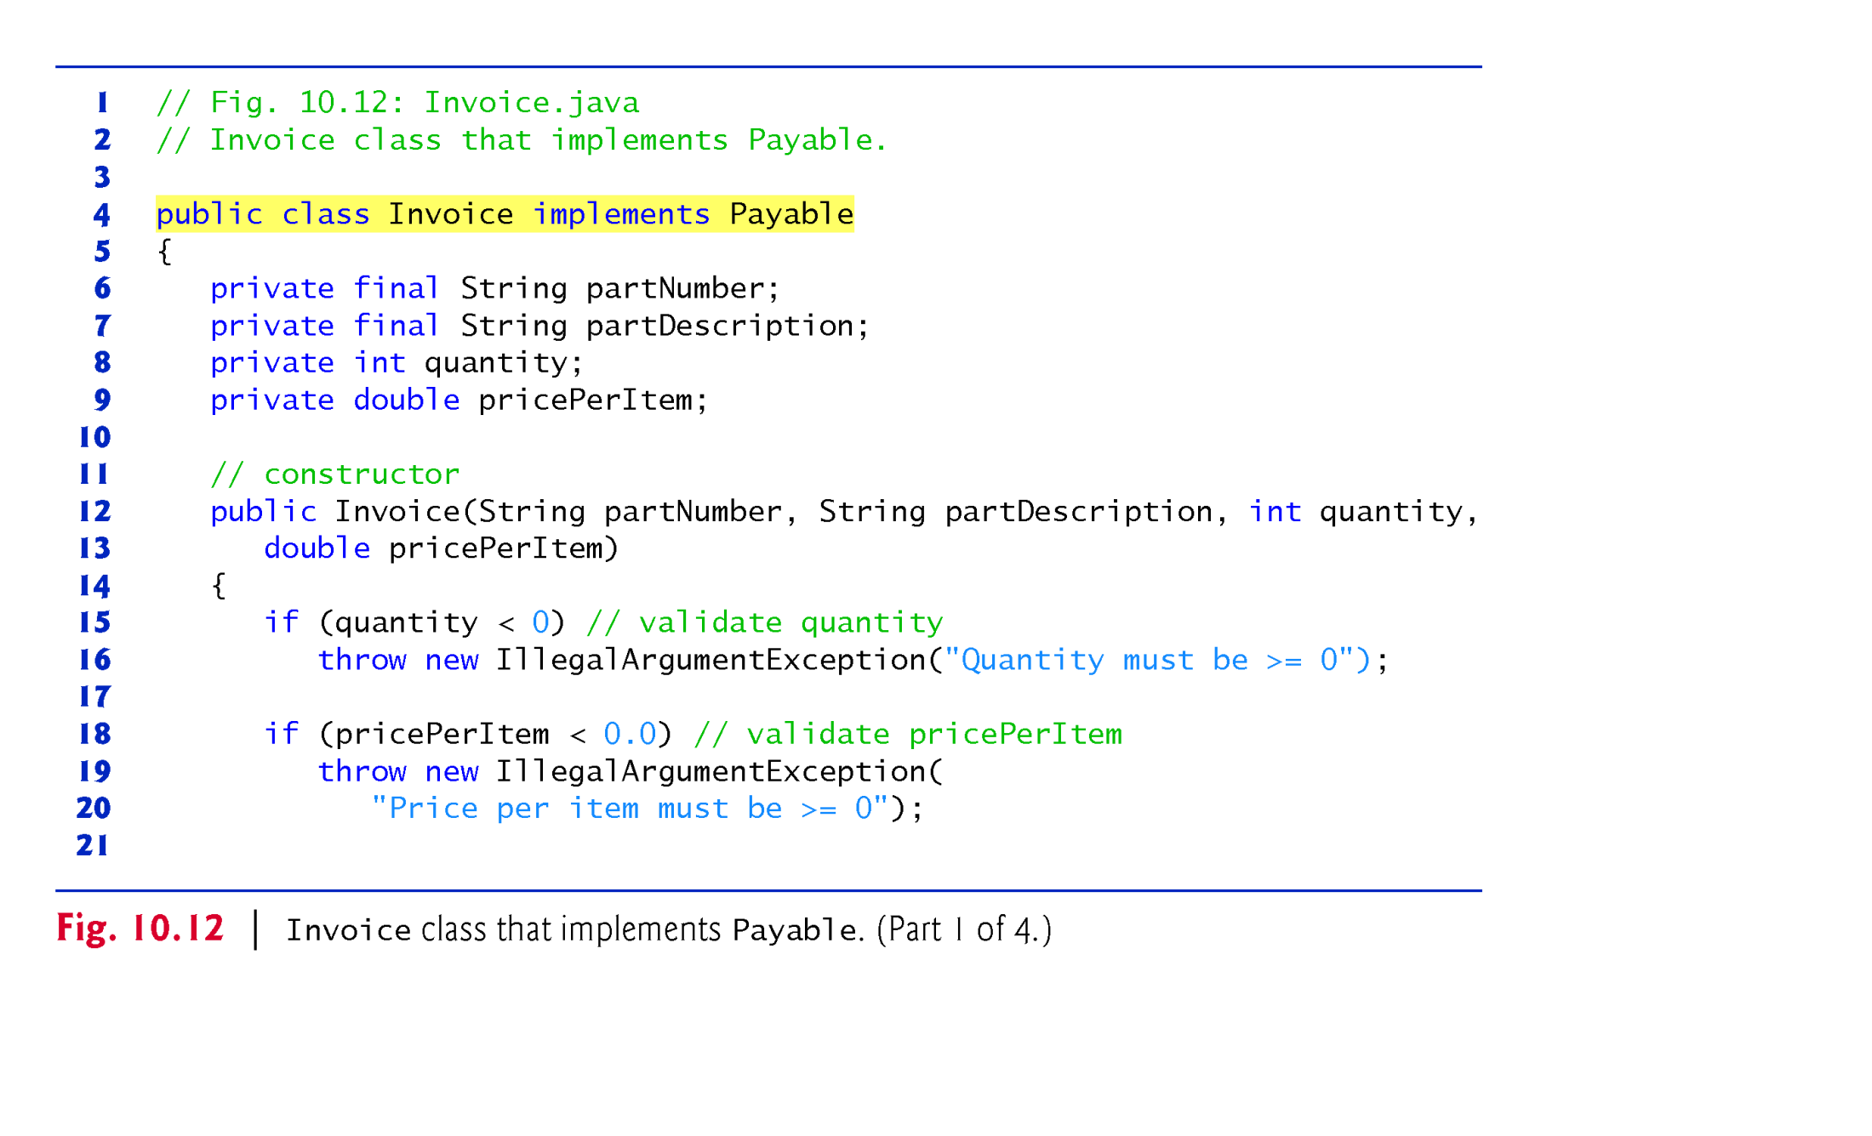
Example 3: Paymnet Application to Employees and Invoices using polymorphism :
Parent class is Interface but child classes are concrete: Invoice class(1/4)
Line 4 : shows a contract agreement between “ invoice” class and compiler

Slide 33
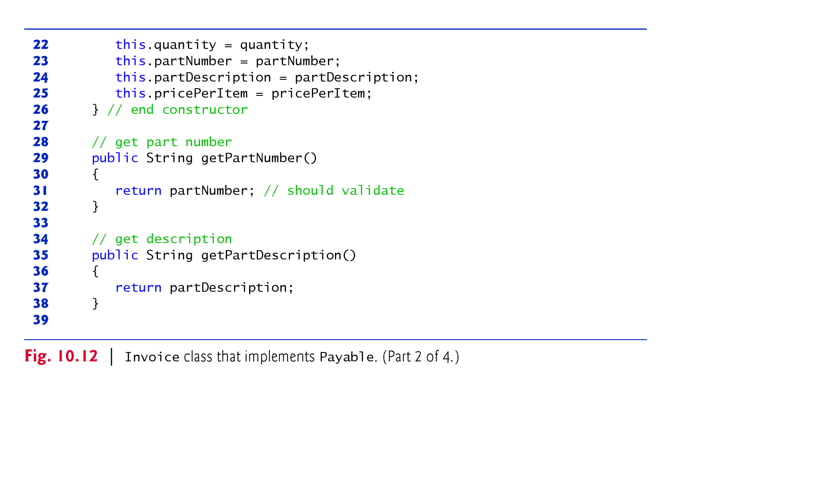
Example 3: Paymnet Application to Employees and Invoices using polymorphism :
Parent class is Interface but child classes are concrete: Invoice class(2/4)

Slide 34
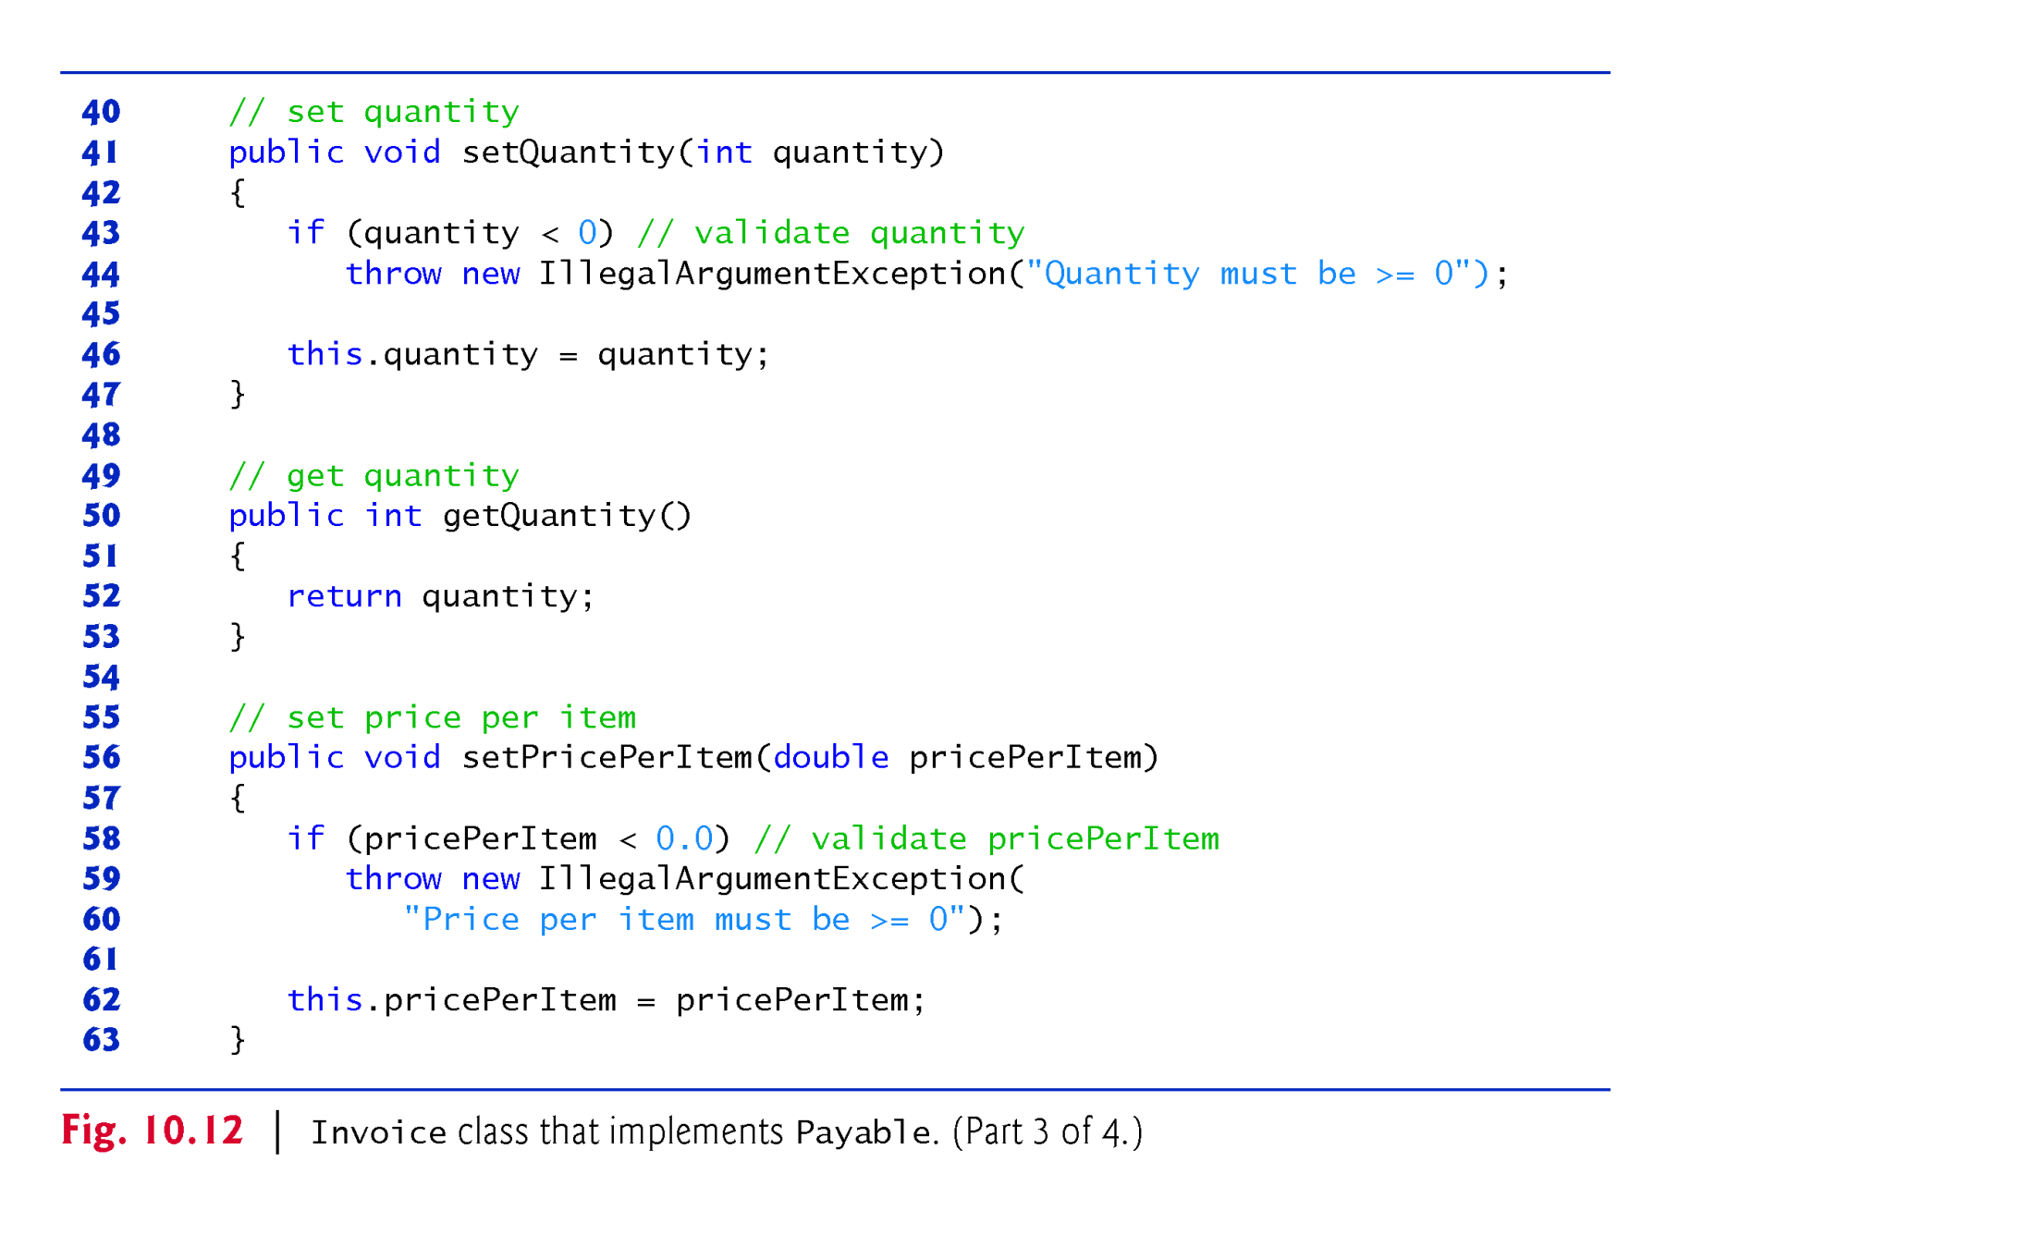
Example 3: Paymnet Application to Employees and Invoices using polymorphism :
Parent class is Interface but child classes are concrete: Invoice class(3/4)

Slide 35
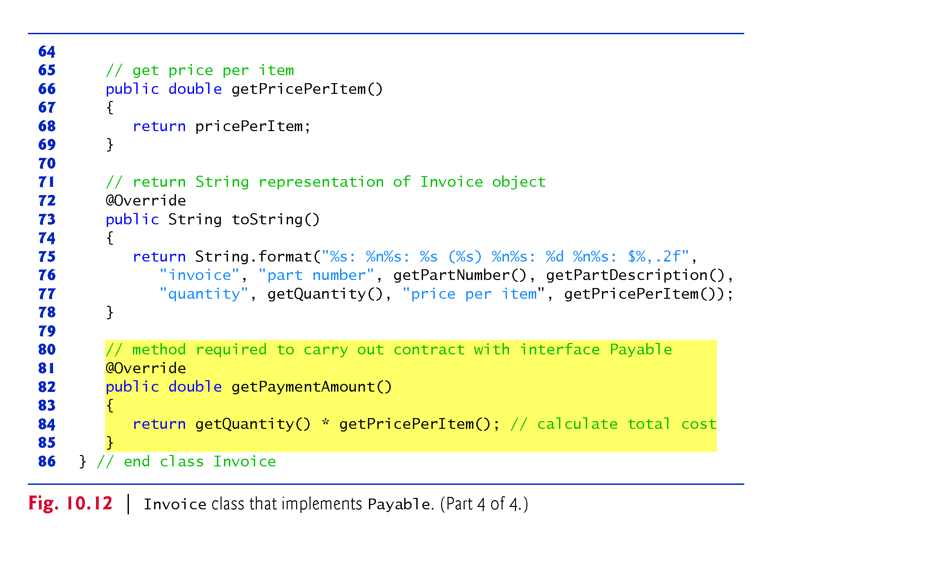
Example 3: Paymnet Application to Employees and Invoices using polymorphism :
Parent class is Interface but child classes are concrete: Invoice class(4/4)

Slide 36
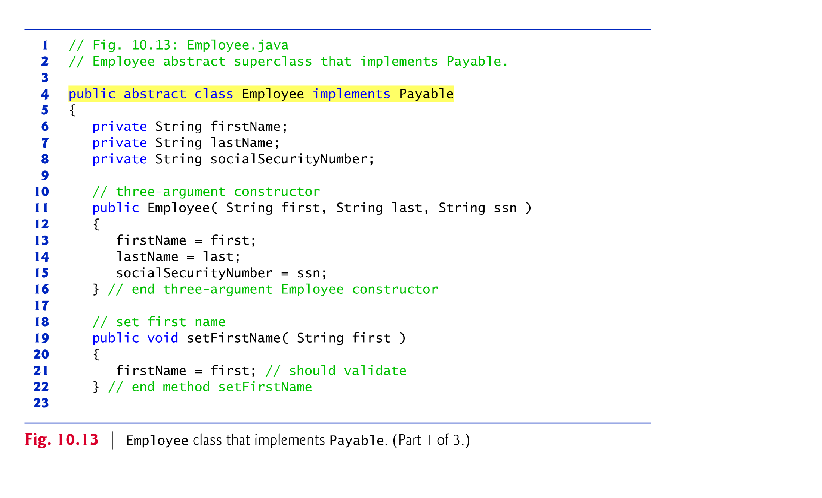
Example 3: Paymnet Application to Employees and Invoices using polymorphism :
Parent class is Interface but child classes are concrete: Employee class(1/3)
Line 4 : shows a contract agreement between “ employee” class and compiler
Since “Employee” class is abstract, its concrete subclasses inherit the contract agreement to implement
Hence, only concrete subclasses implement “getPaymentAmount()”
Employee e=new Employee();
// compilation error

Slide 37
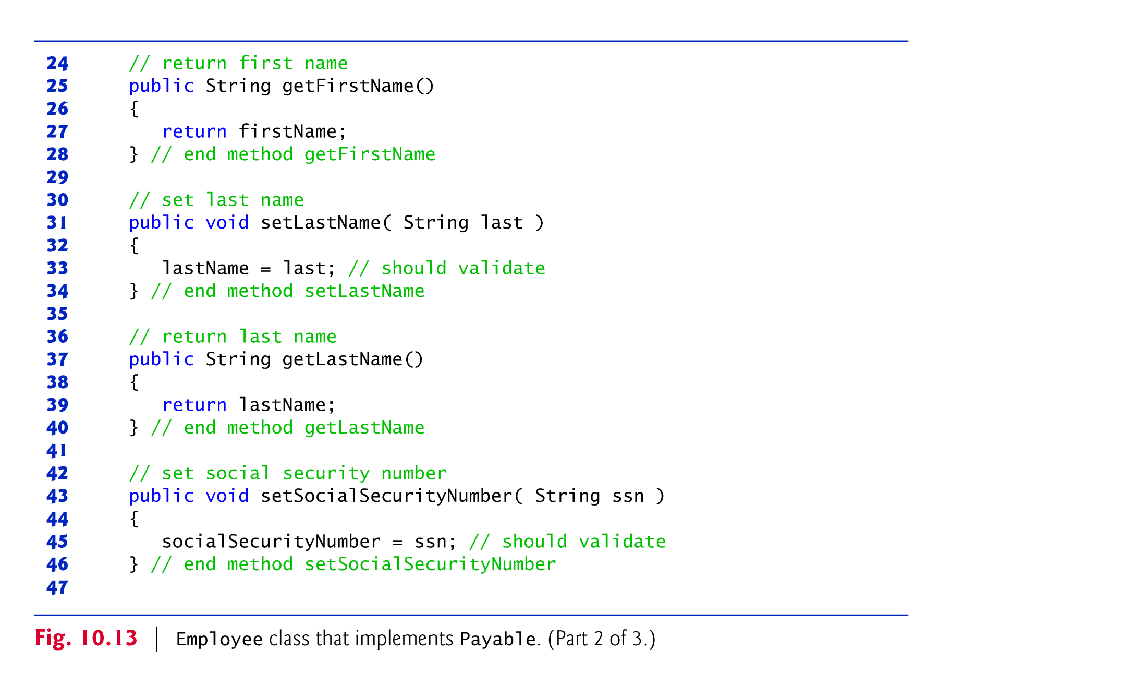
Example 3: Paymnet Application to Employees and Invoices using polymorphism :
Parent class is Interface but child classes are concrete: Employee class(2/3)

Slide 38
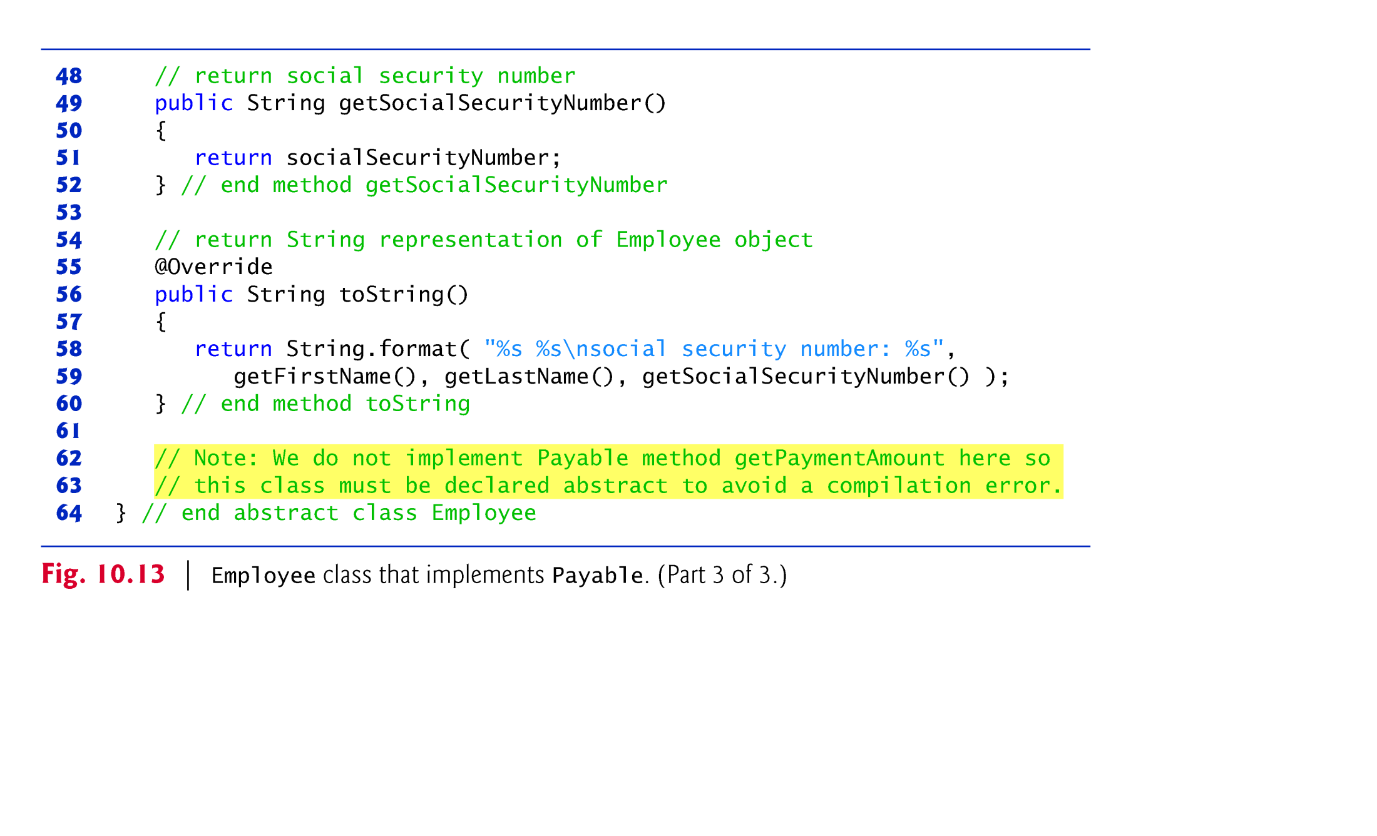
Example 3: Paymnet Application to Employees and Invoices using polymorphism :
Parent class is Interface but child classes are concrete: Employee class(3/3)
Line 62-64 : “Employee” does not implement “getPaymnetAmount();
Hence, this method did not re-appear in this class.

Slide 39
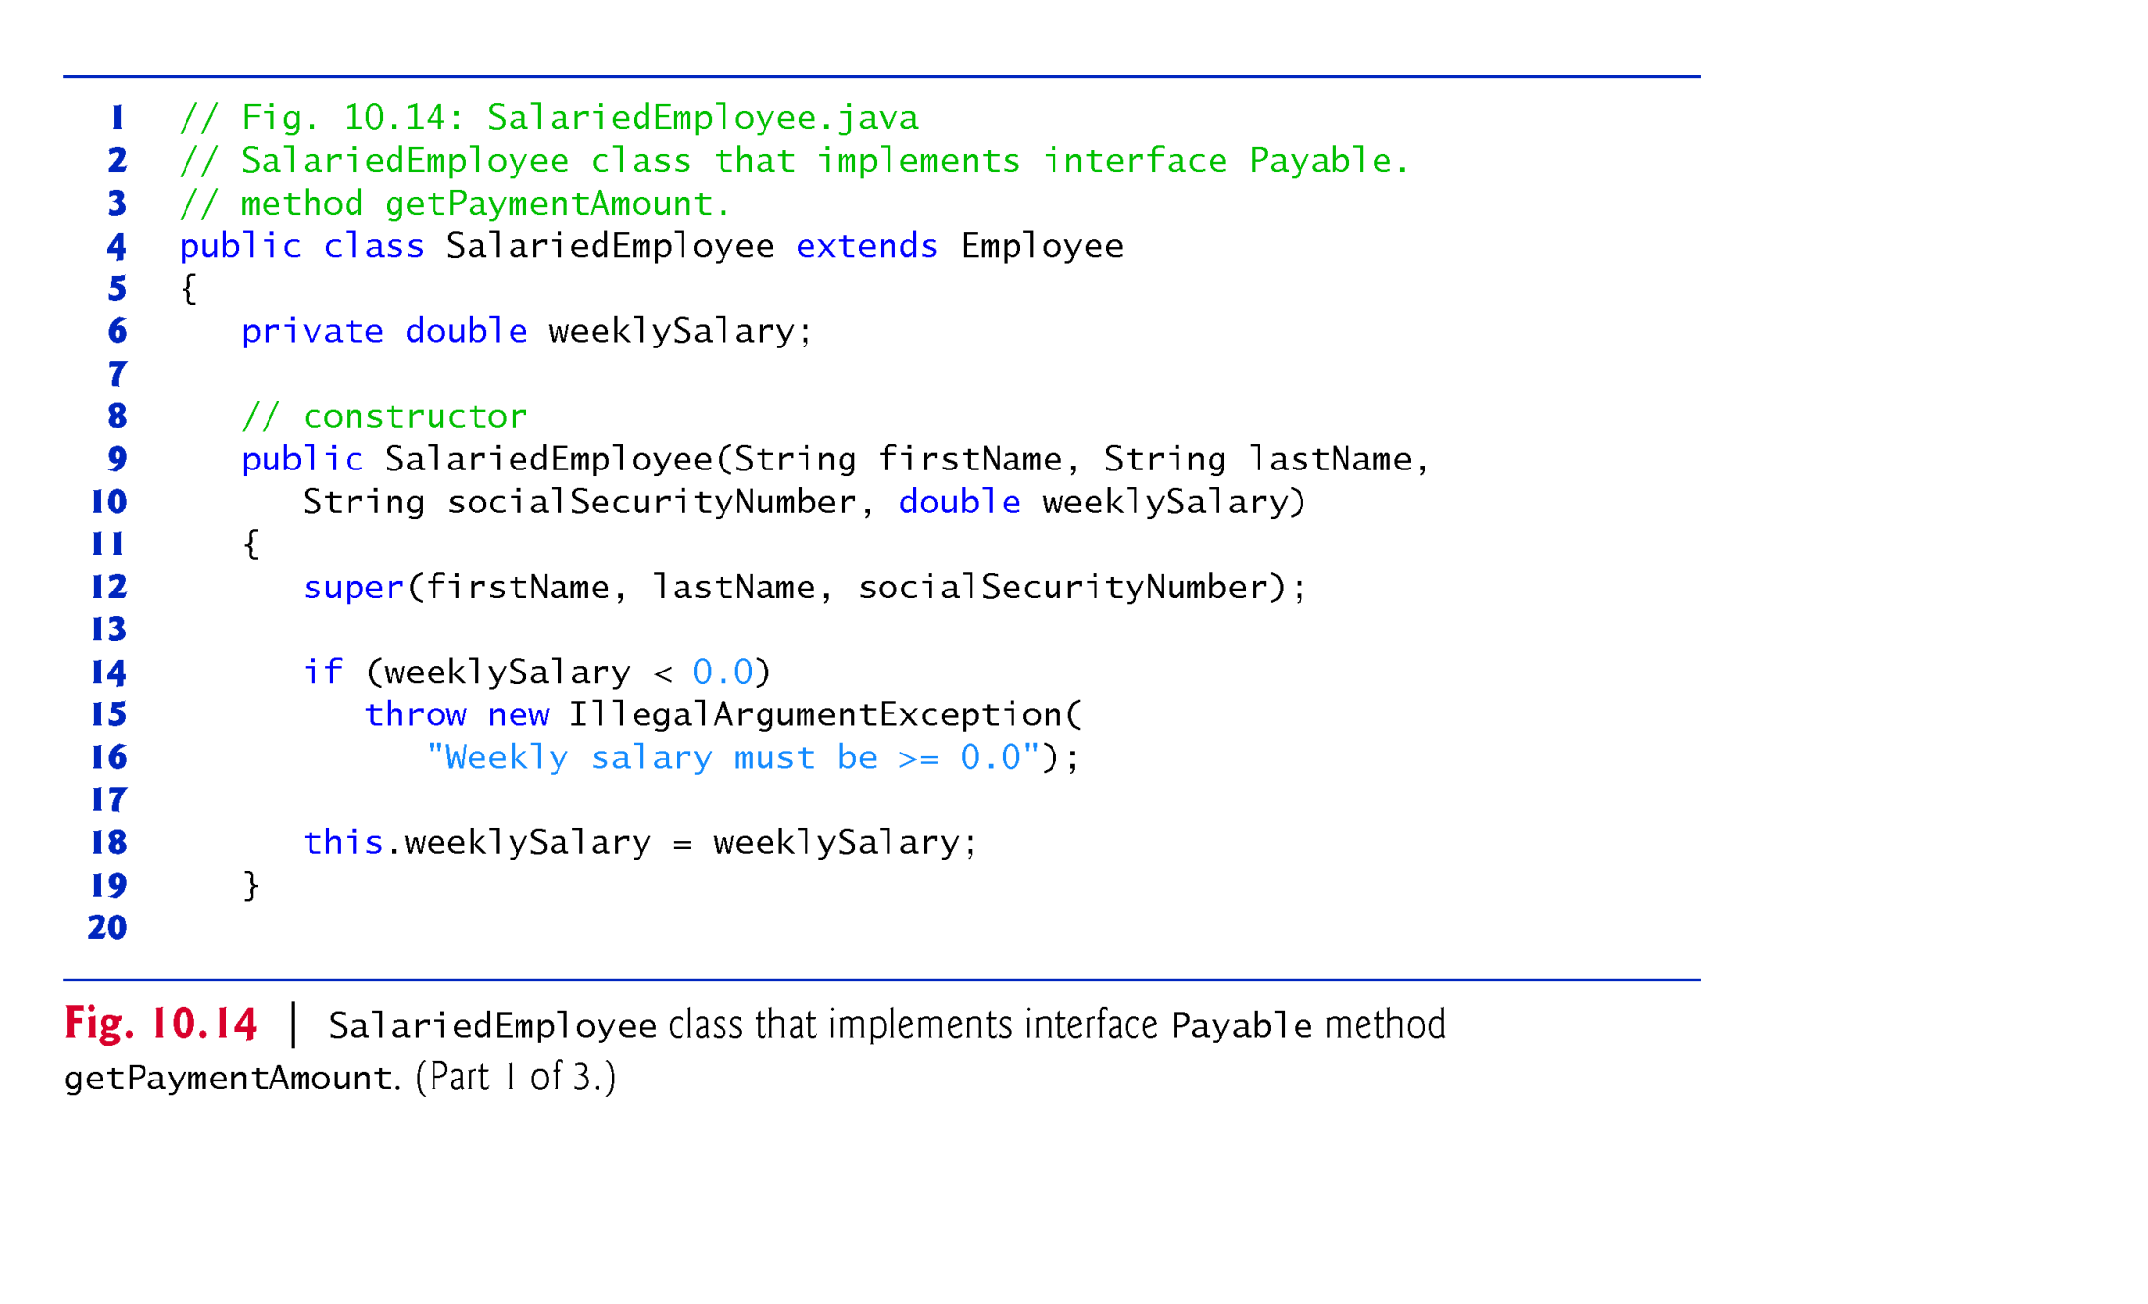
Example 3: Paymnet Application to Employees and Invoices using polymorphism :
Parent class is Interface but child classes are concrete: SalariedEmployee(1/3)

Slide 40
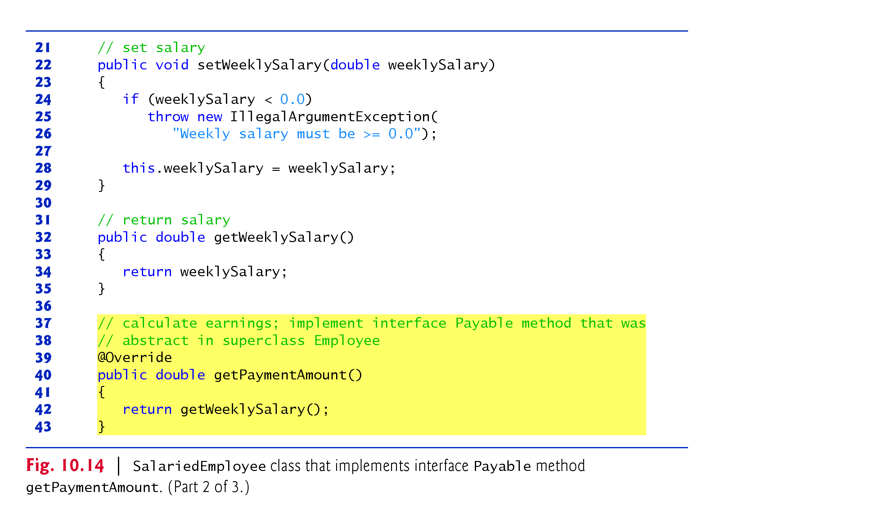
Example 3: Paymnet Application to Employees and Invoices using polymorphism :
Parent class is Interface but child classes are concrete: SalariedEmployee(2/3)

Slide 41
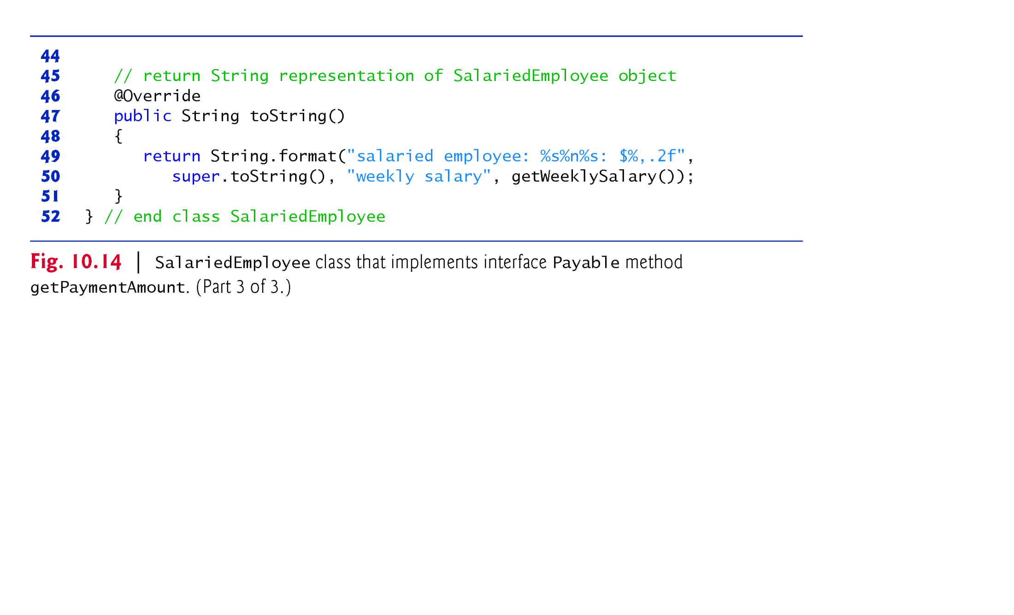
Example 3: Paymnet Application to Employees and Invoices using polymorphism :
Parent class is Interface but child classes are concrete: SalariedEmployee(3/3)

Slide 42
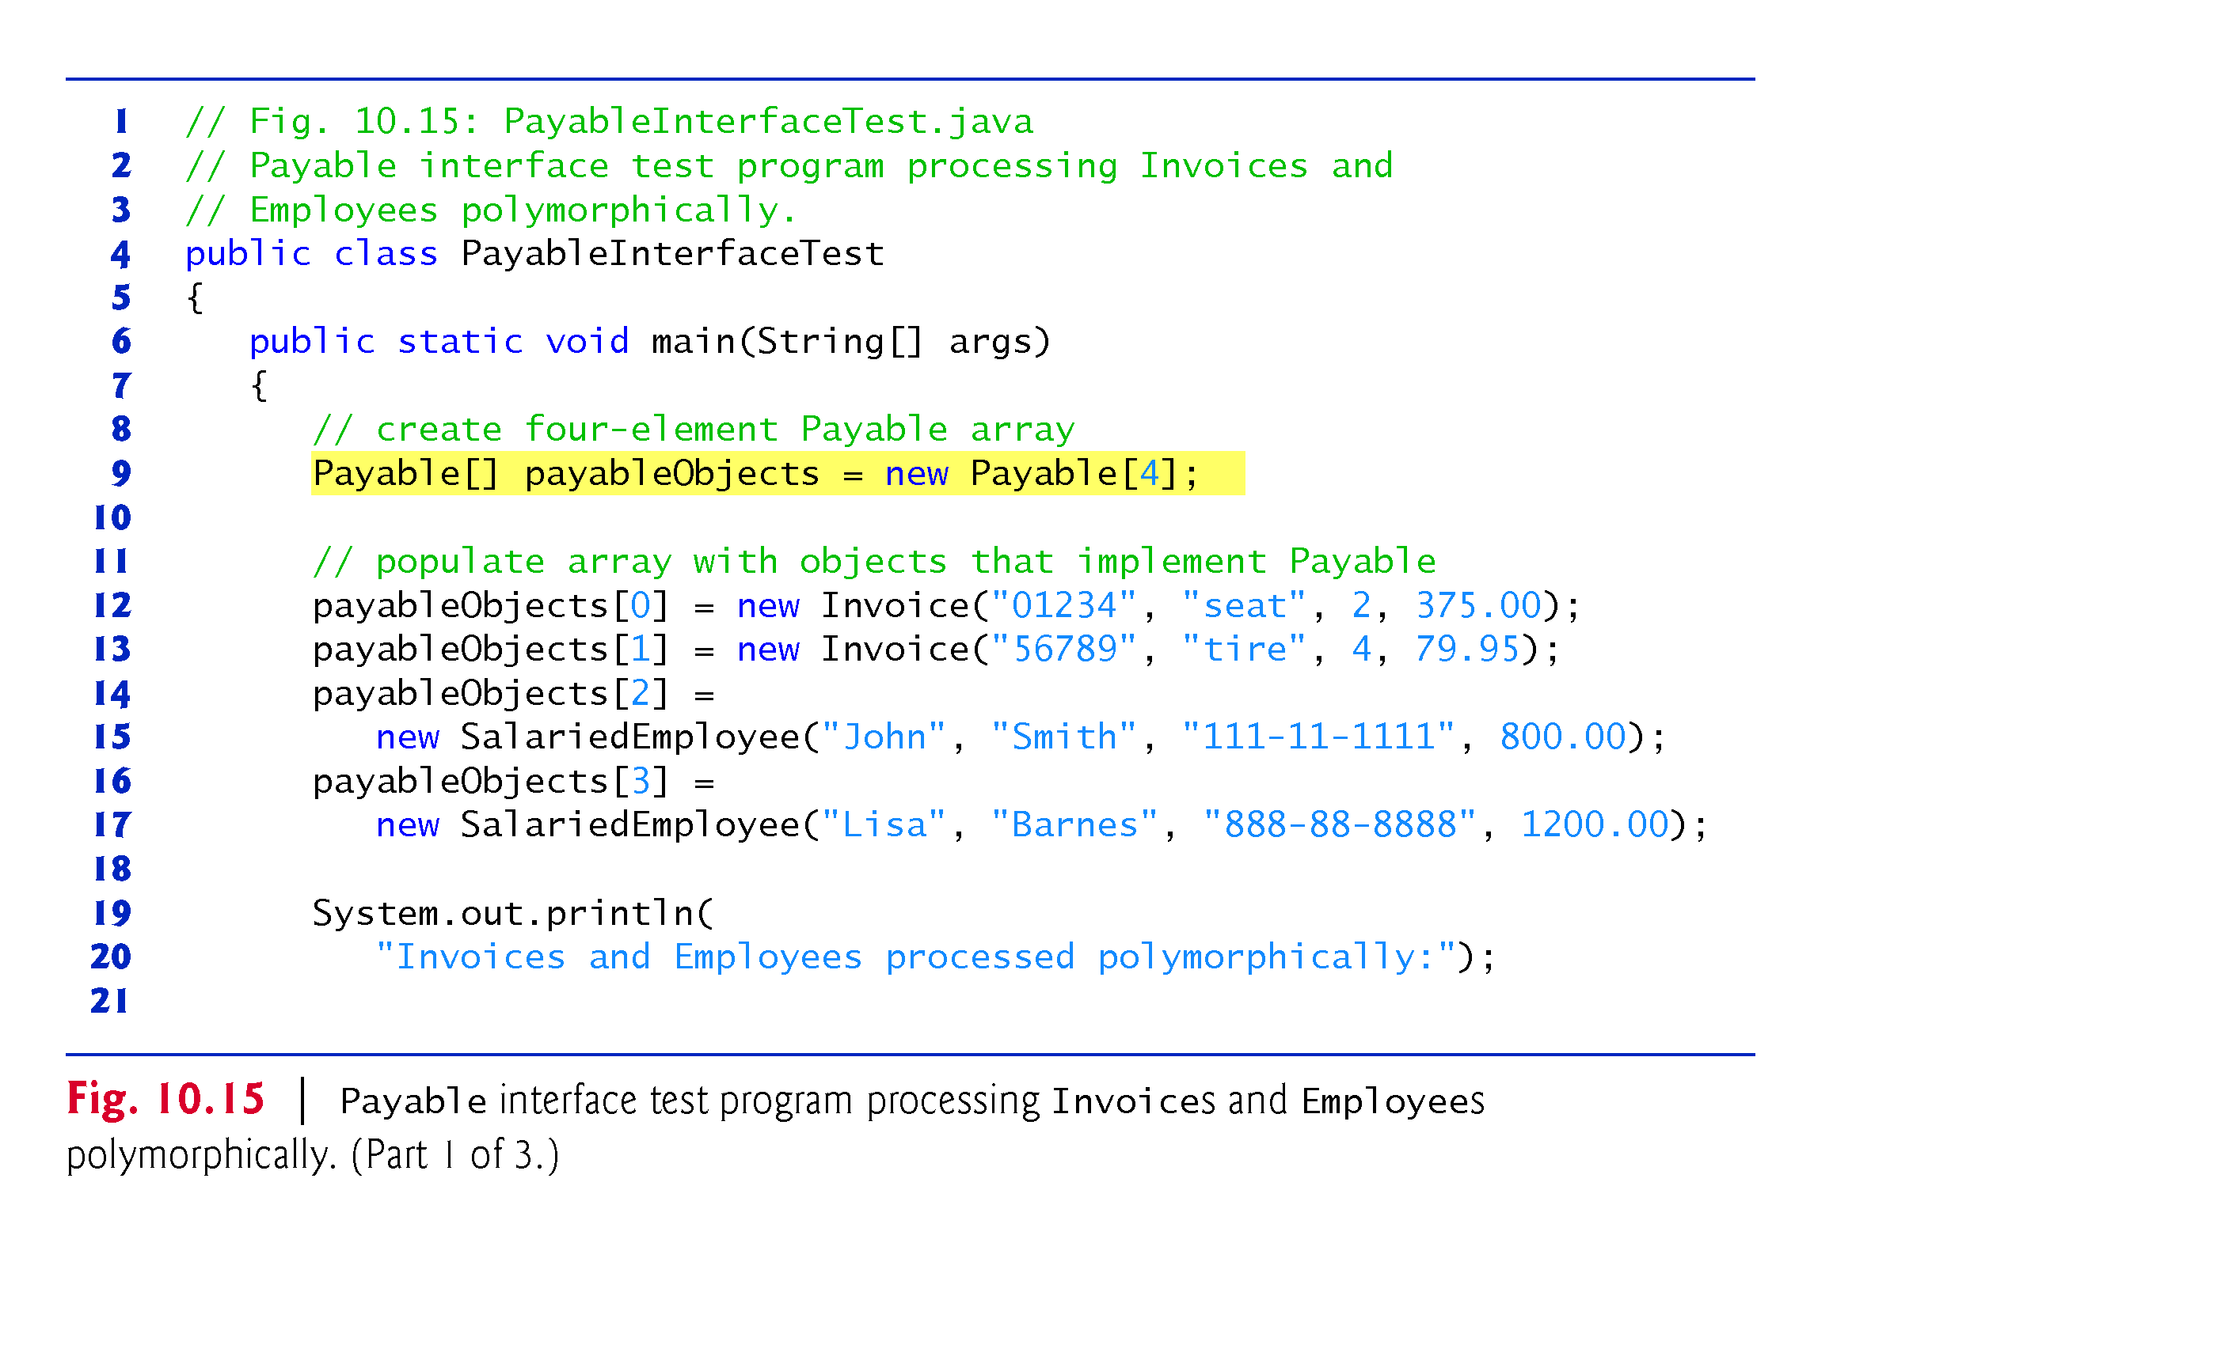
Example 3: Paymnet Application to Employees and Invoices using polymorphism :
Parent class is Interface but child classes are concrete: PayableInterfaceTest(1/3)
Line 9: objects are not created
Line 12-17:
Payable p = new Payable(); // error
Payable p = new Employee(); // error
Payable p= new Invoice(); // up cast

Slide 43
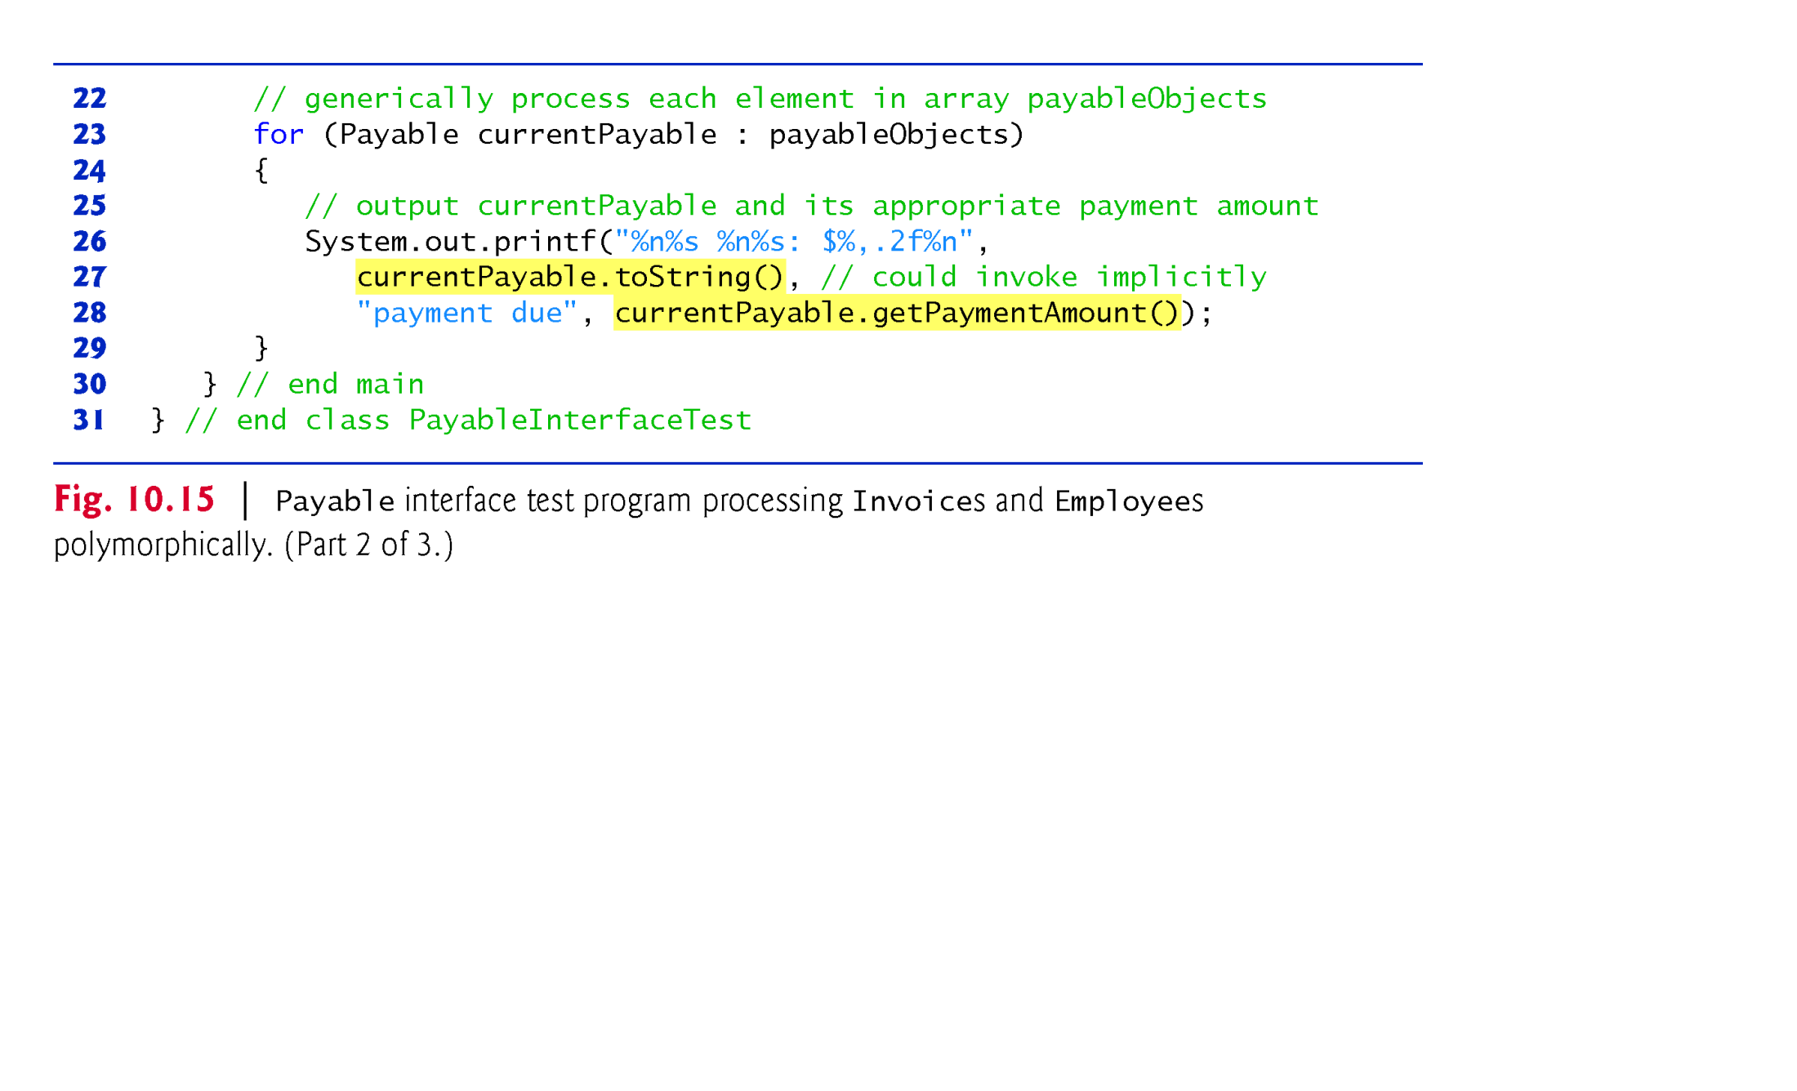
Example 3: Paymnet Application to Employees and Invoices using polymorphism :
Parent class is Interface but child classes are concrete: PayableInterfaceTest(2/3)
Line 12-17: IS-A relationship also applied for interface hierarchy
Payable p = new SalariedEmployee(); // correct
Payable p= new Invoice();// correct
Line 27: Although “Payable” Interface has no “ toString()”, there is no error because Payable variable refers to an object on heap area which inherits the “toString()” method from the root class called “Object”.

Slide 44
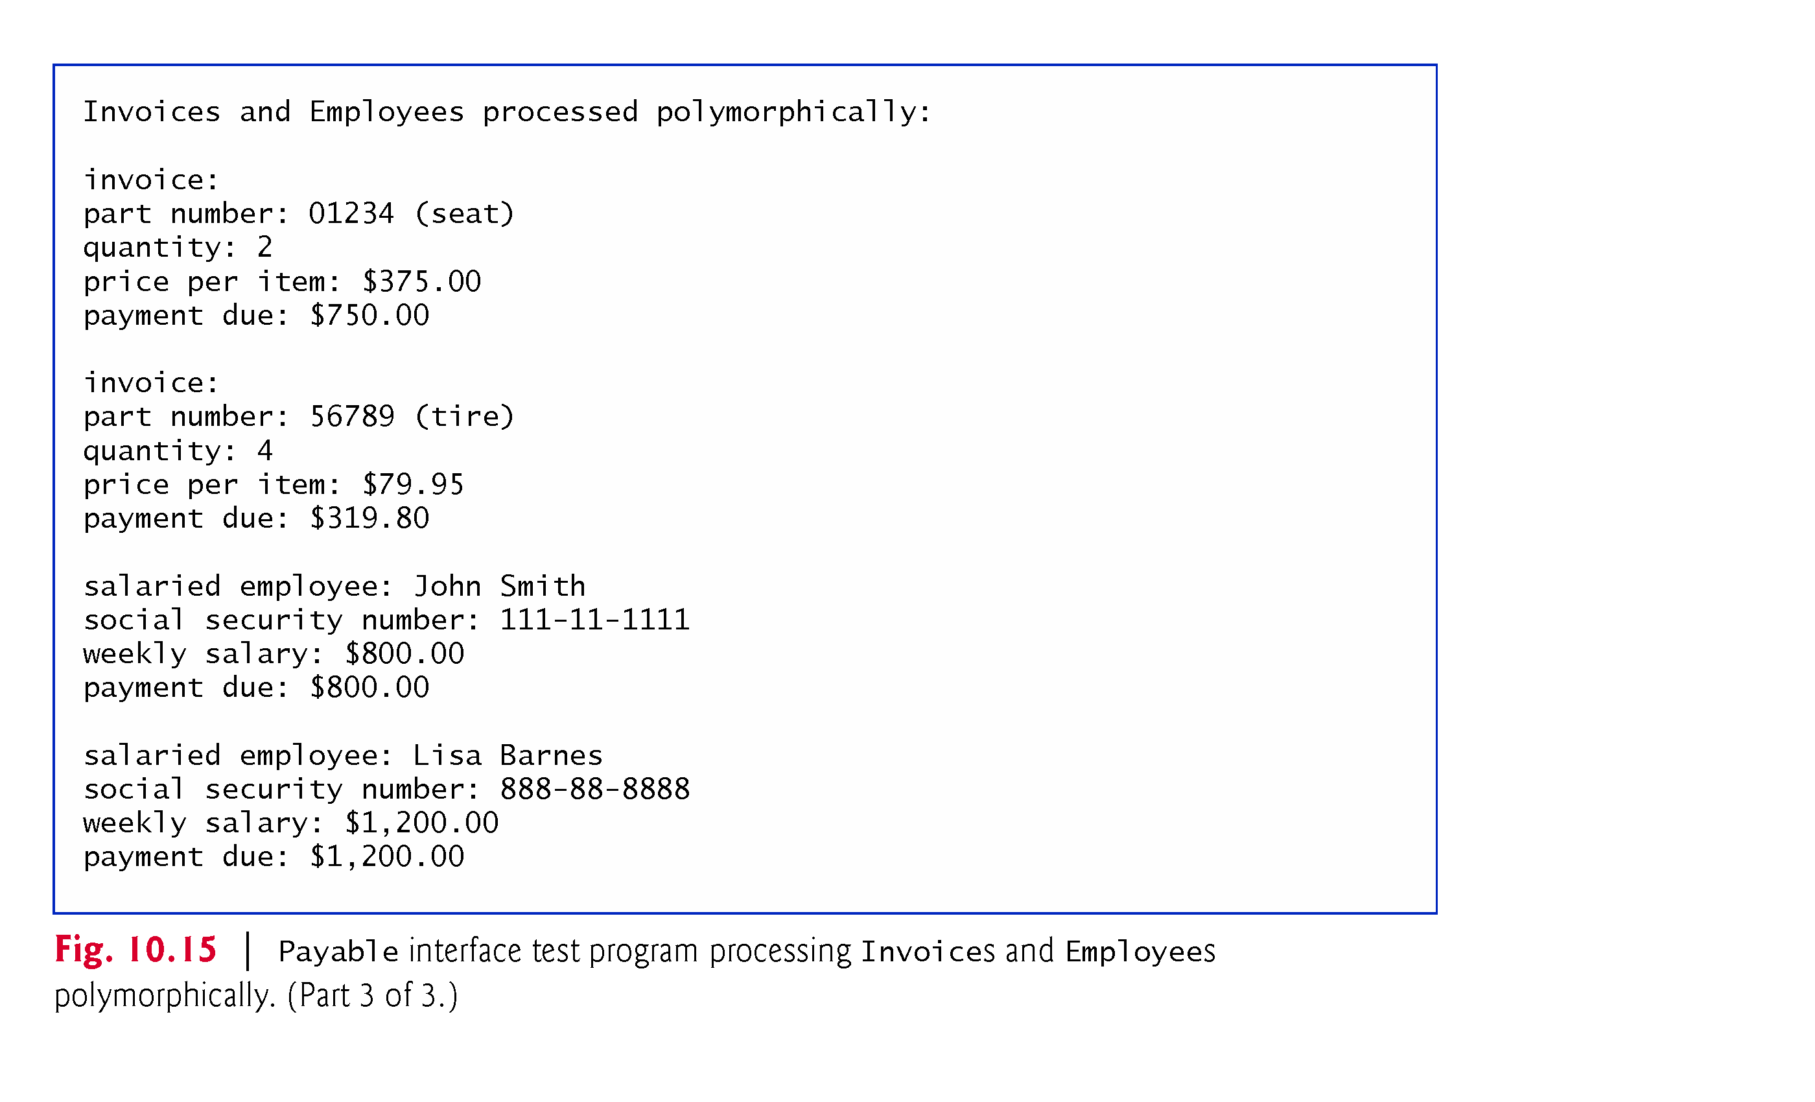
Example 3: Paymnet Application to Employees and Invoices using polymorphism :
Parent class is Interface but child classes are concrete: Output

